Slide 1
Variations on a Theme

Slide 2
The Cow Skull

Slide 3
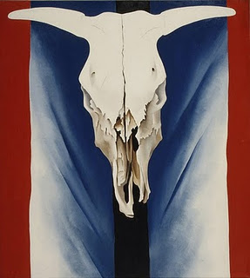
Cow's Skull: Red, White and Blue Georgia O'Keeffe

Slide 4
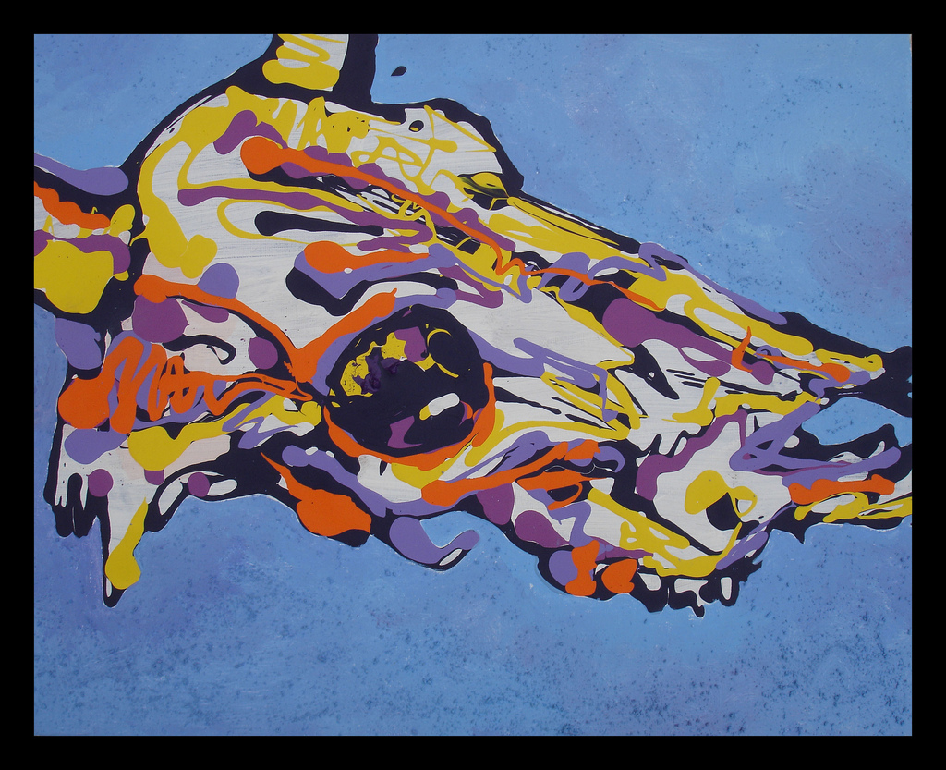
drippy cow skull Evan Lovejoy

Slide 5
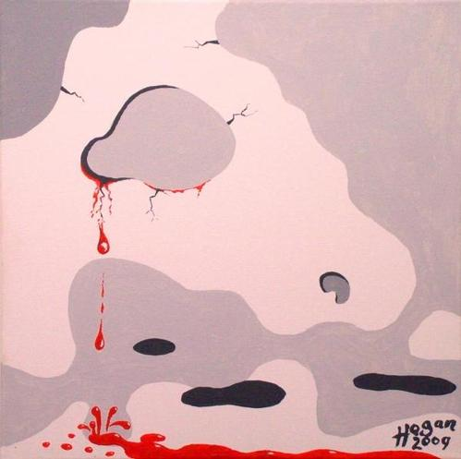
Tears of the Last Cow Alan Hogan

Slide 6
The Dog

Slide 7
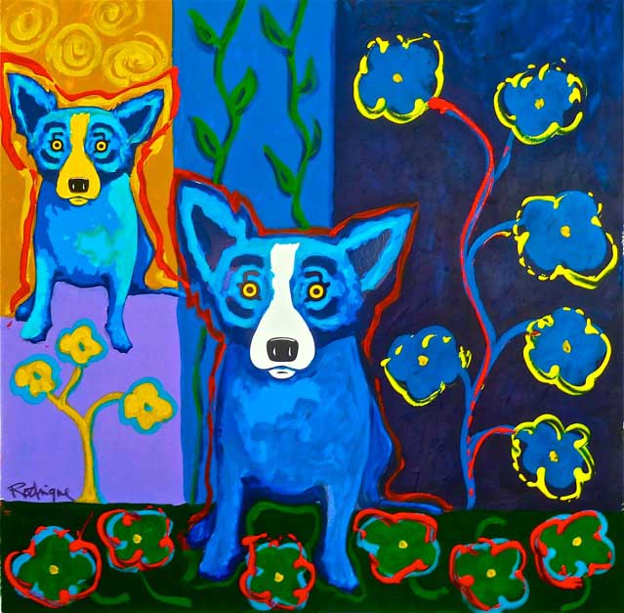
Blue Dog George Rodrigue

Slide 8
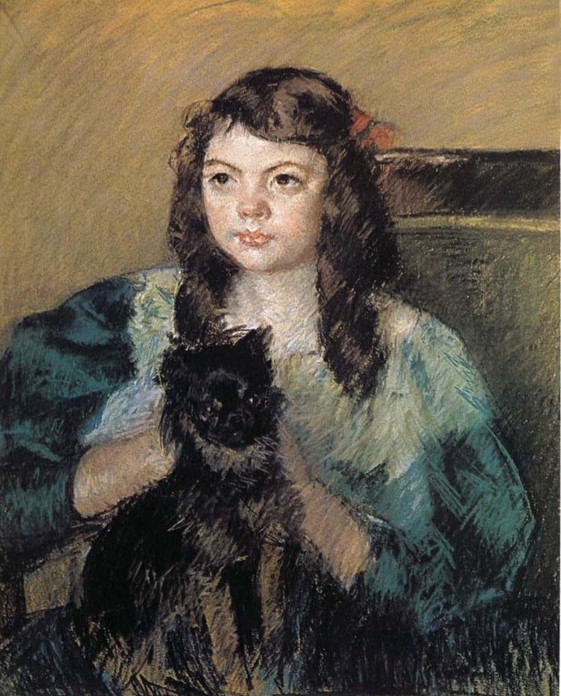
The Girl Holding the Dog Mary Cassatt

Slide 9
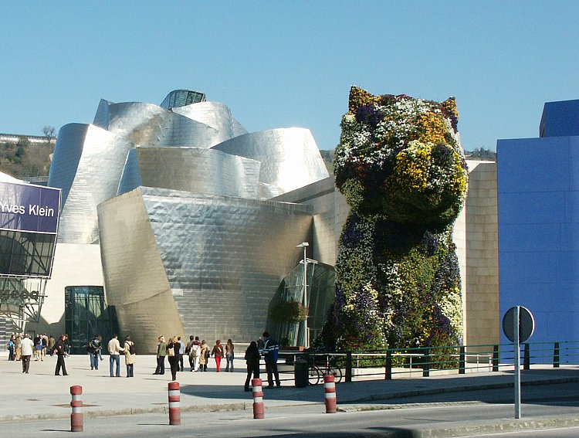
Guggenheim Puppy Jeff Koons

Slide 10
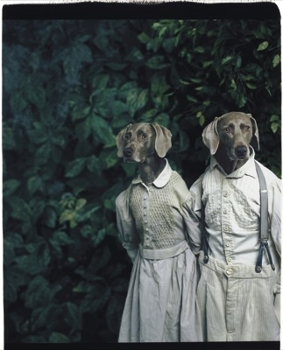
Hansel und Gretel William Wegman

Slide 11
Flowers

Slide 12
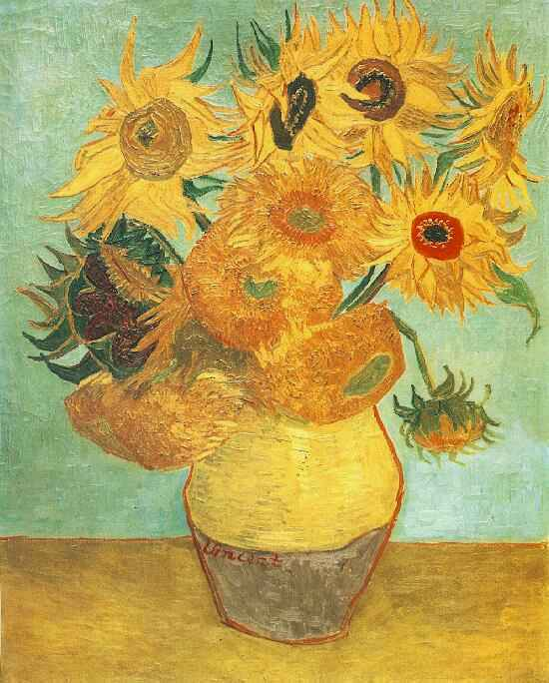
Sunflowers Vincent van Gogh

Slide 13
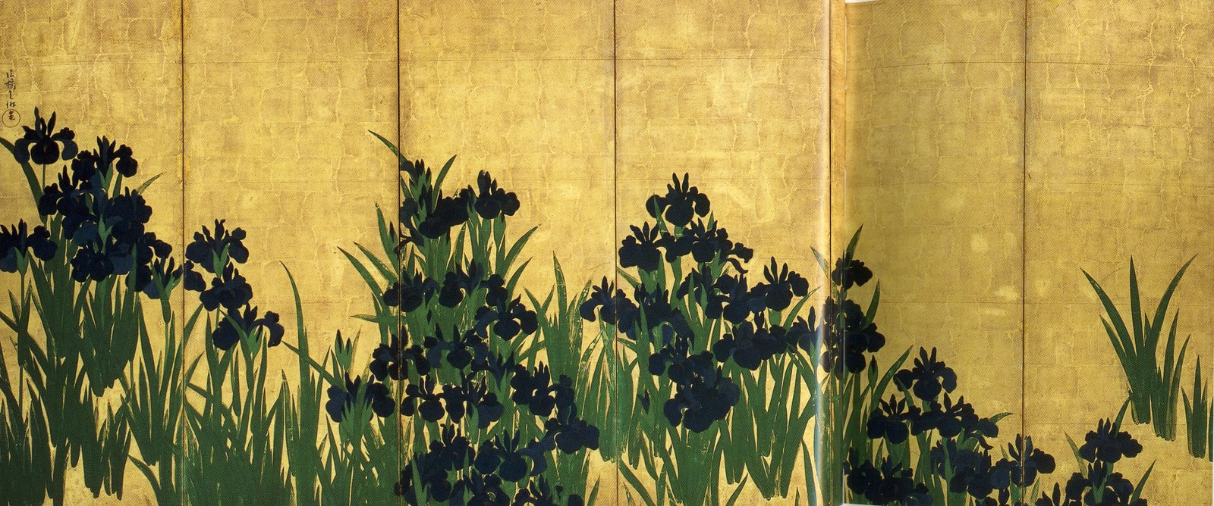
Irises Ogata Korin

Slide 14
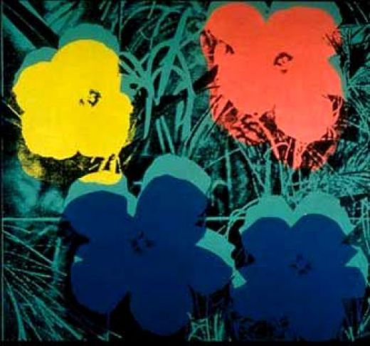
Ten-foot Flowers Andy Warhol

Slide 15
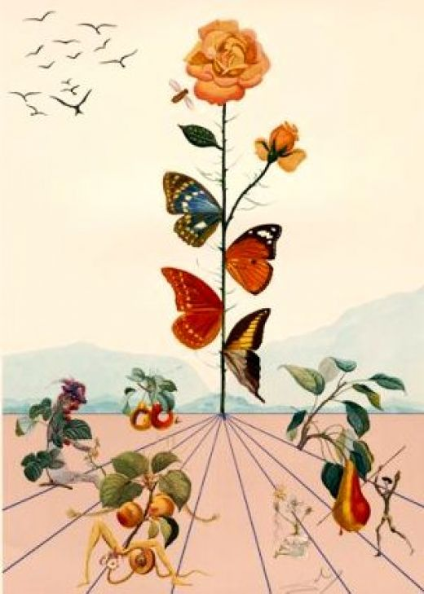
Salvadore Dali Flor Dali

Slide 16
You will create a Painting incorporating one of the following objects: -Plants -Animals -Machines

Slide 17
You will create 4 different thumbnail sketches. Your designs should have at least a foreground and background (think overlapping) You will then create a rough color scheme of your best design. Then you paint it.

Slide 18
This will count as part of your final for Visual Art I.
You should be demonstrating your ability to:
mix color
use painting techniques
think creatively
complete quality work in a timely manner

