Slide 1
Narrative Self-Portrait:
Your Face
/
Your Story

Slide 2
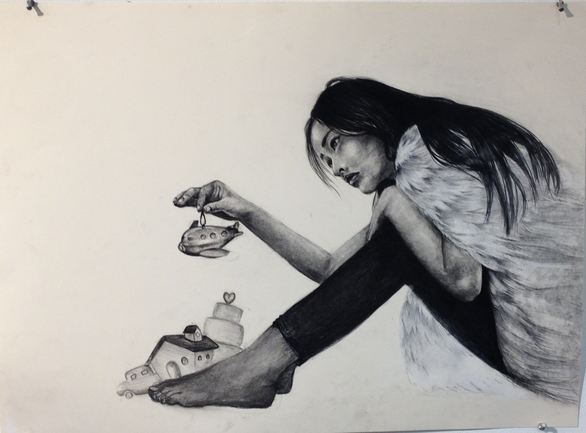

Slide 3
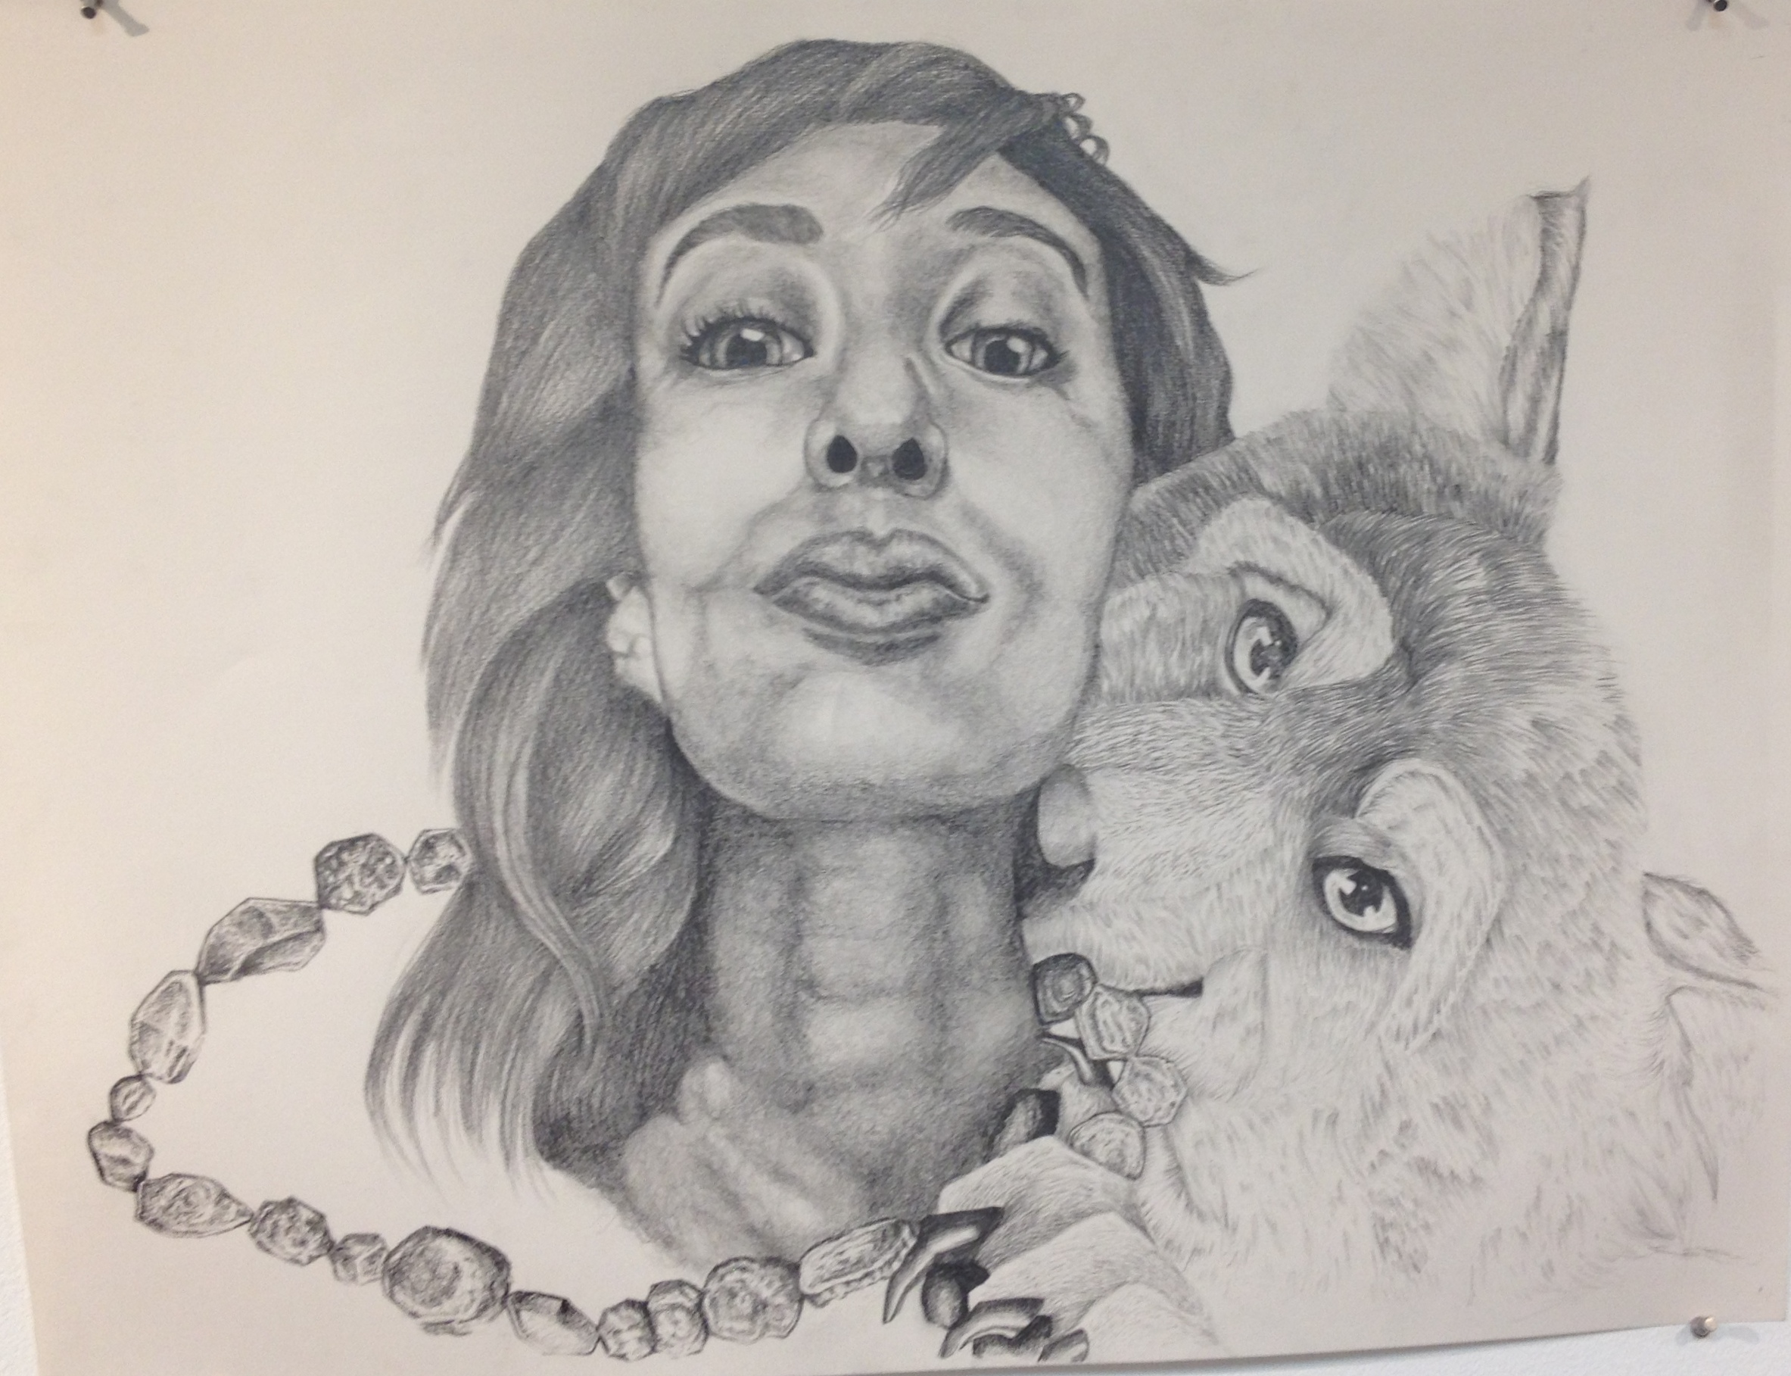

Slide 4
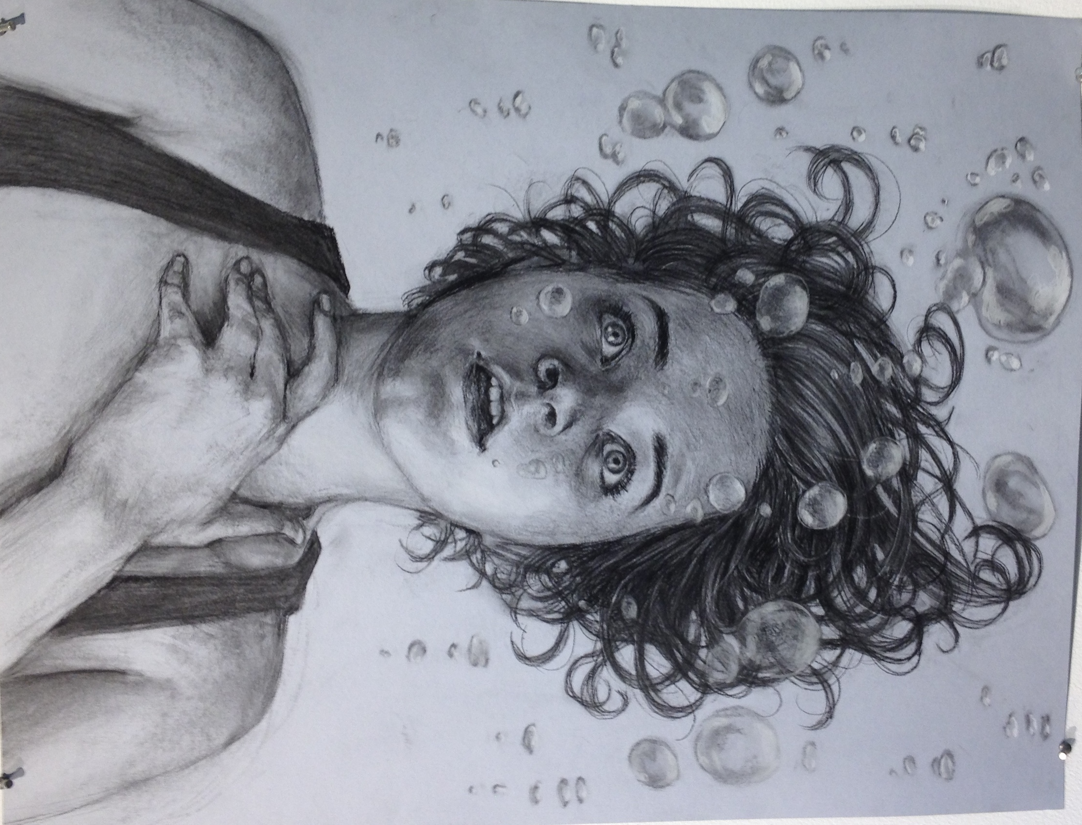

Slide 5
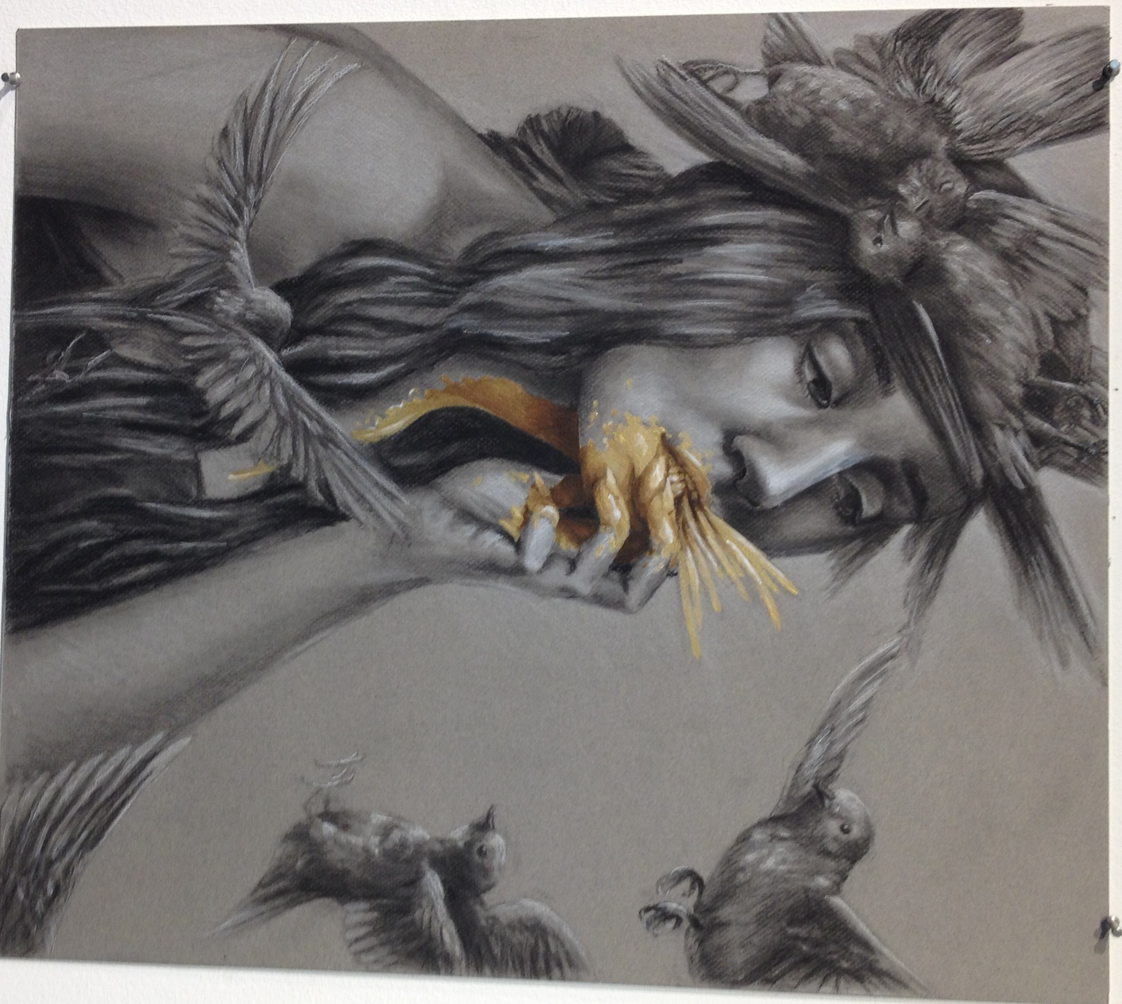

Slide 6
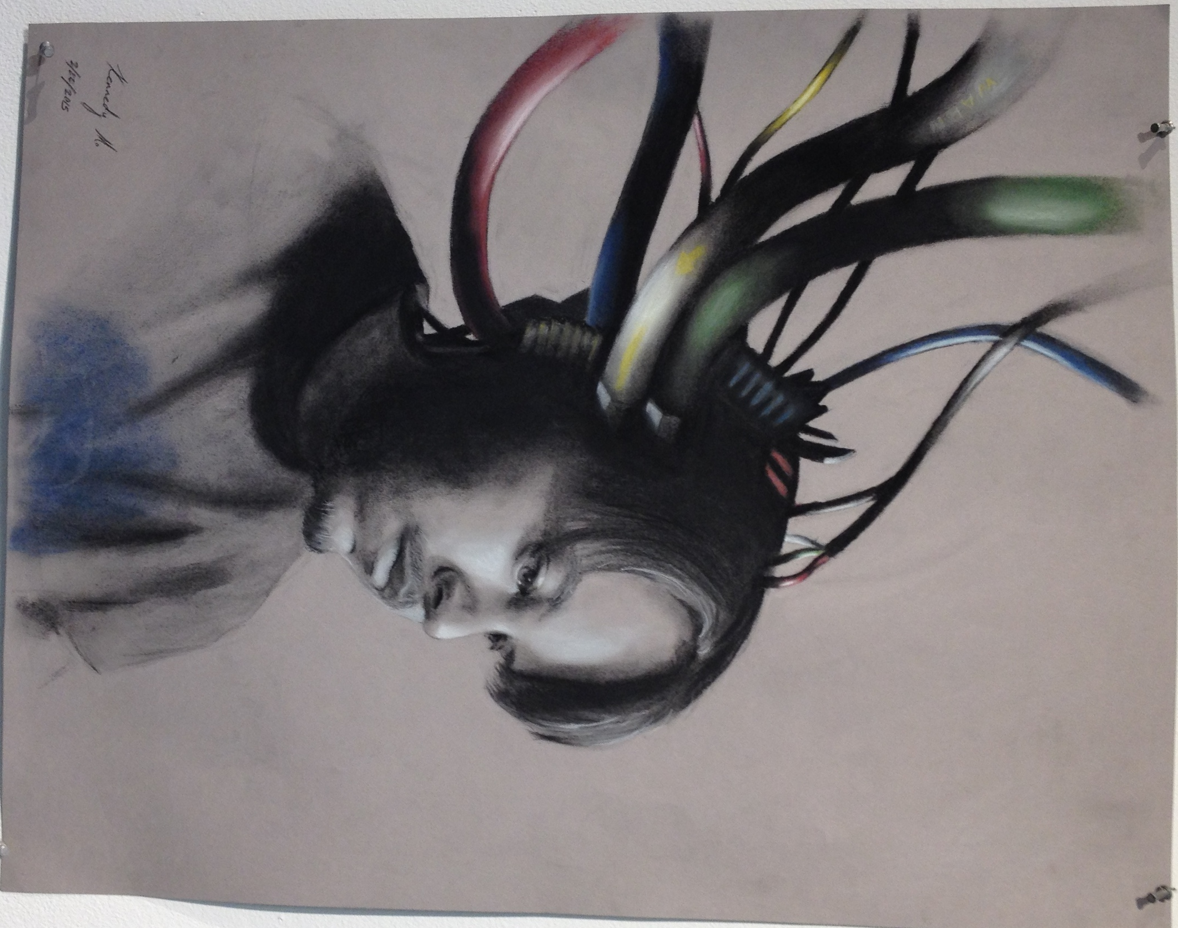

Slide 7
You will:
Use sighting, grids and measuring to create accurate proportions, angles, positive/negative shapes as they apply to the figure.
Manipulate a variety of line and shading to render the figure.
Demonstrate understanding of the placement of weight and balance of the figure
Draw the figure in complex poses.
Incorporate the figure into the picture plane.
Create a narrative that guides your image

