Slide 1
Micrography
Greek, literally small-writing – (Μικρογραφία)
Jewish form of calligrams developed in the 9th century, with parallels in Christianity and Islam, utilizing minute Hebrew letters to form representational, geometric and abstract designs.
The artwork is created from text that forms an image when viewed at a distance, creating an interplay between the text and image.
There is a relationship between this form of art, employing both digital and analogic symbols, and the restrictions on images found in the 2nd commandment. Micrography provides a unique solution to the visual artist who wishes to remain devout in observation of Jewish law, by using only text, not images per se. As similar restrictions exist in certain Muslim societies, this solution has been adapted in Islamic calligraphy to the Arabic alphabet as well.

Slide 2
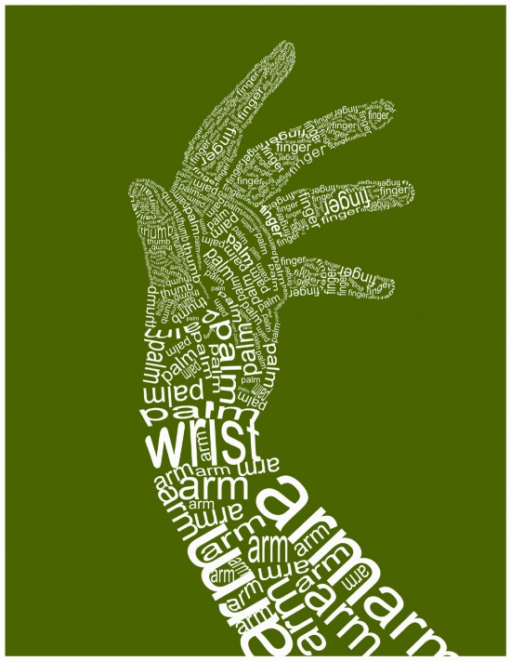
Micrography
Calligram

Slide 3
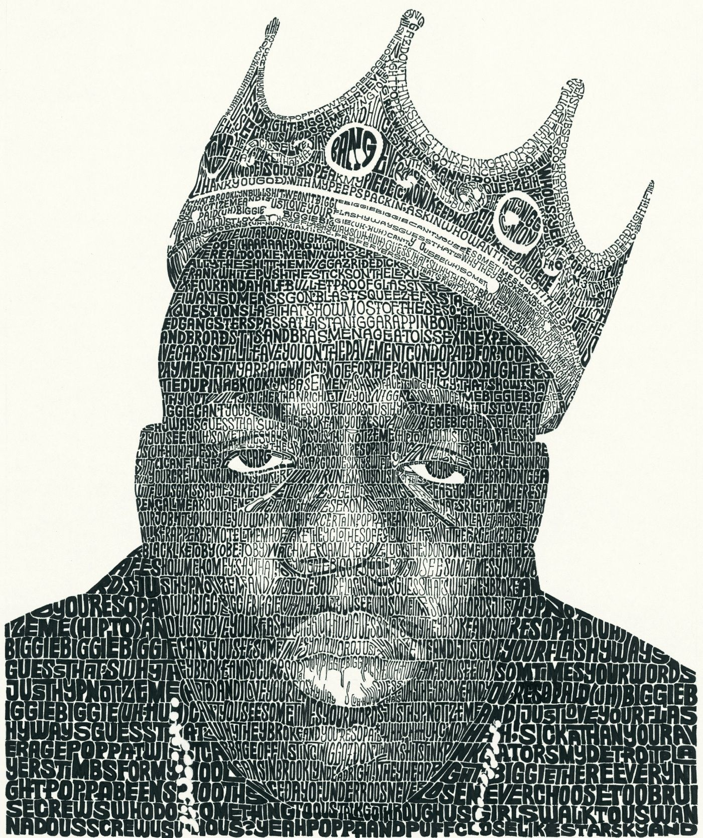

Slide 4
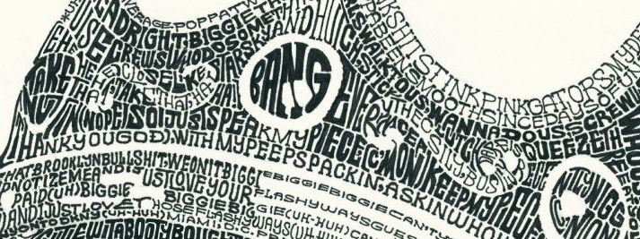

Slide 6
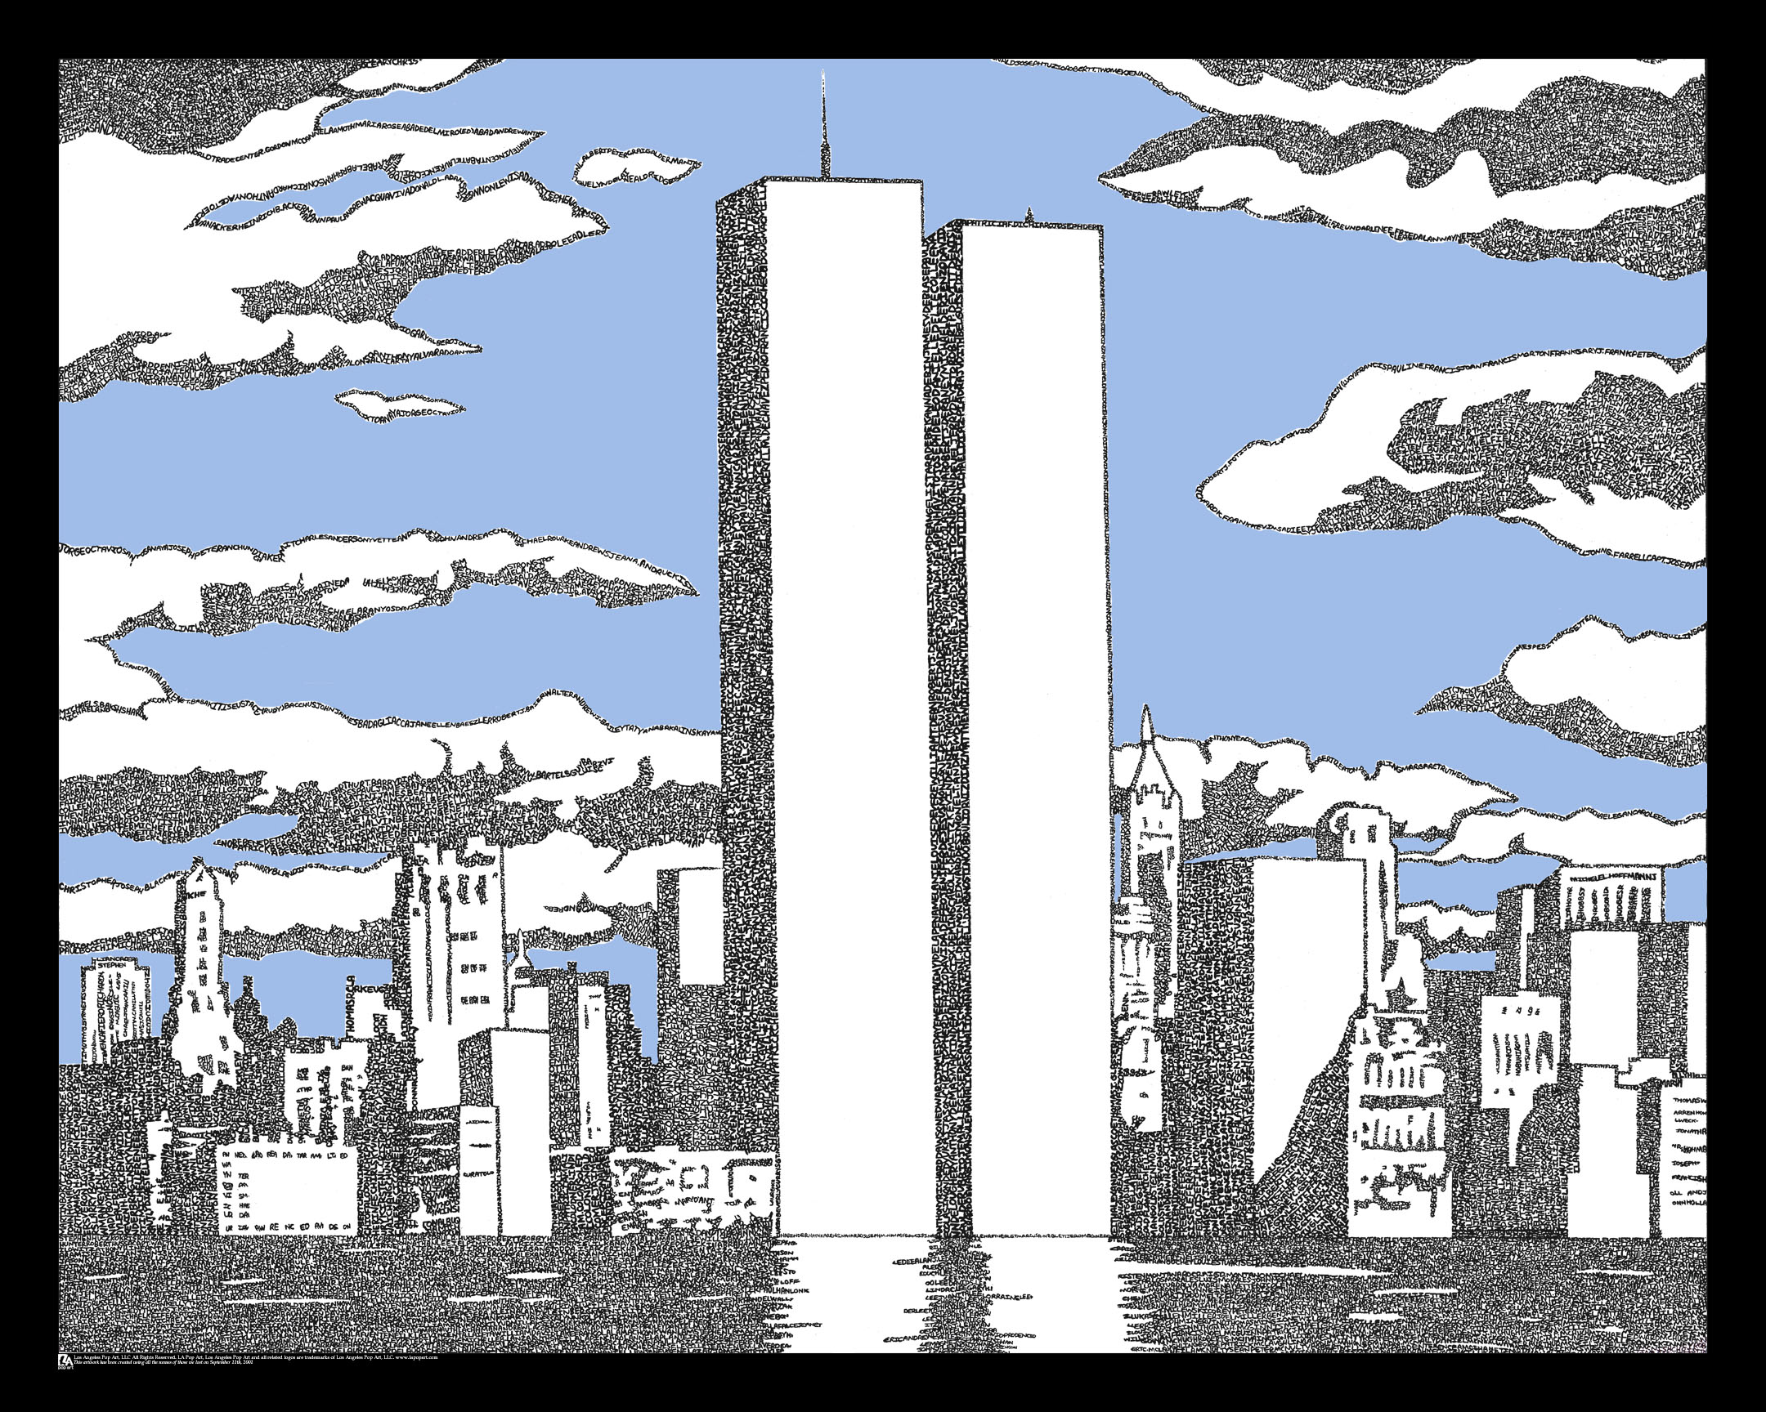

Slide 7
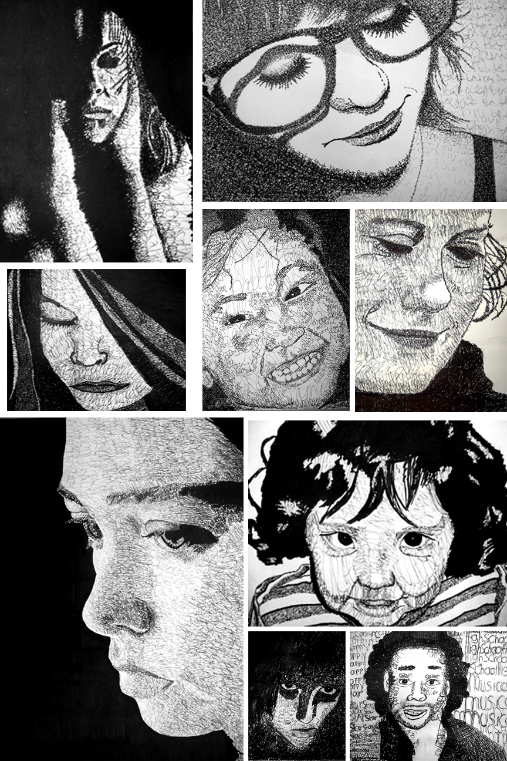

Slide 9
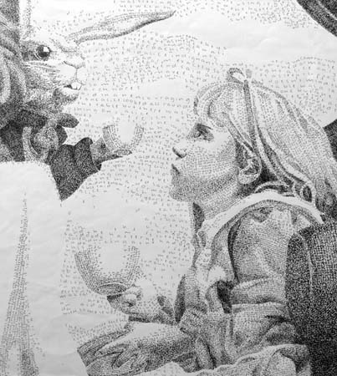

Slide 10
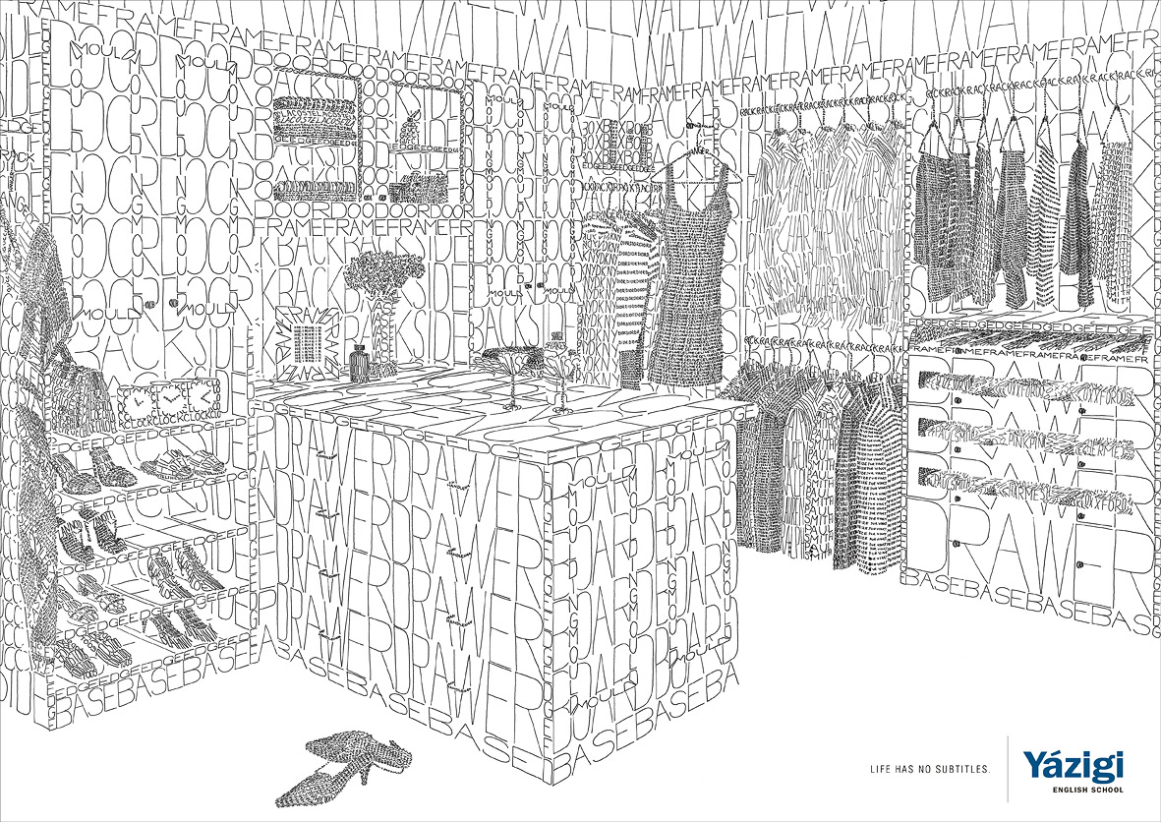

Slide 11
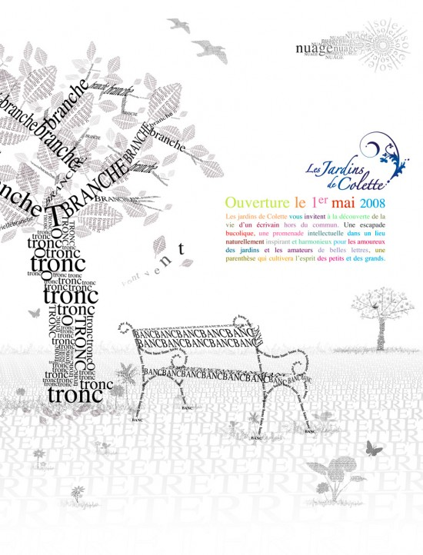

Slide 13
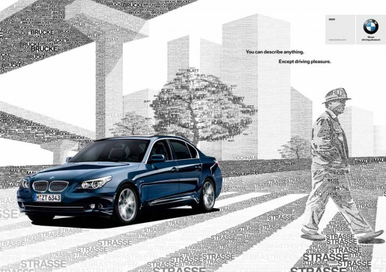

Slide 15
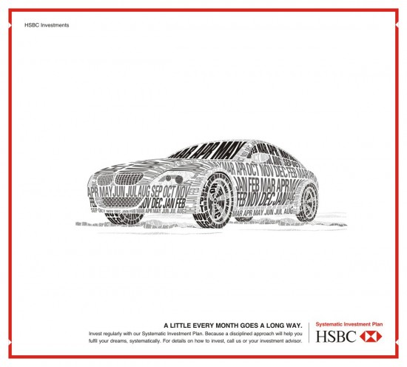

Slide 16
For Monday :
Find a photo that is meaningful to you.
Should include a minimum of 3 objects
You will need to turn in a hard copy with your final drawing. (I can make photocopies/print images out.)
You can email images to me at: peter.edwards@madison.kyschools.us

