Slide 1
Diptych
1: a 2-leaved hinged tablet folding together to protect writing on its waxed surfaces
2: a picture or series of pictures (as an altarpiece) painted or carved on two hinged tablets
3: a work made up of two matching parts

Slide 2
Concepts to Consider for Your Diptych

Slide 3
Tell A Story

Slide 4
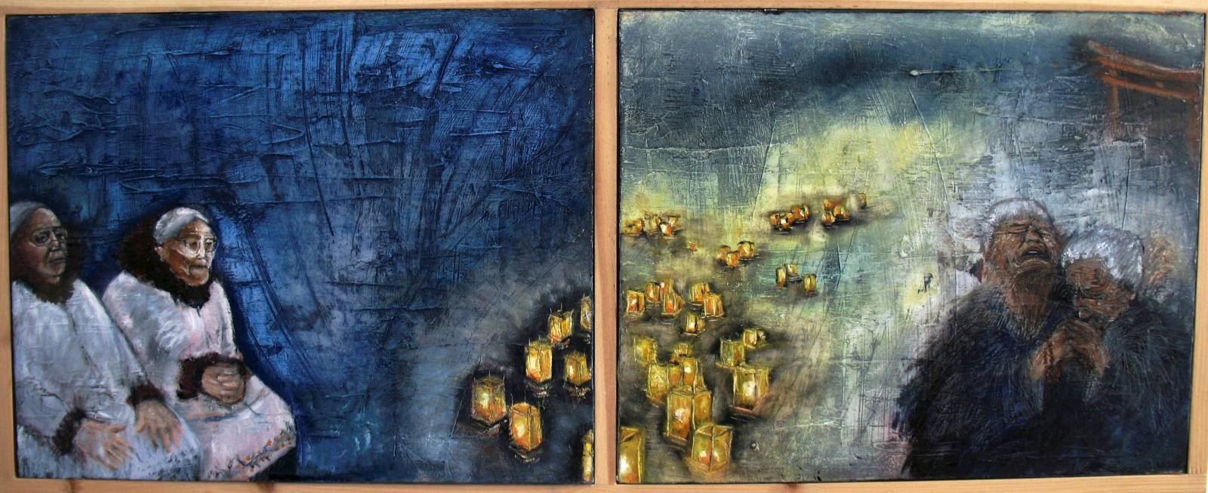
Or A Story

Slide 5
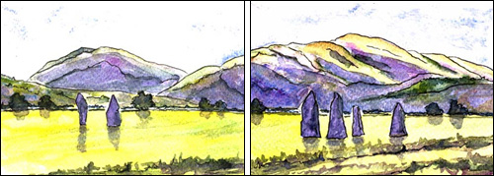
Show a place

Slide 6
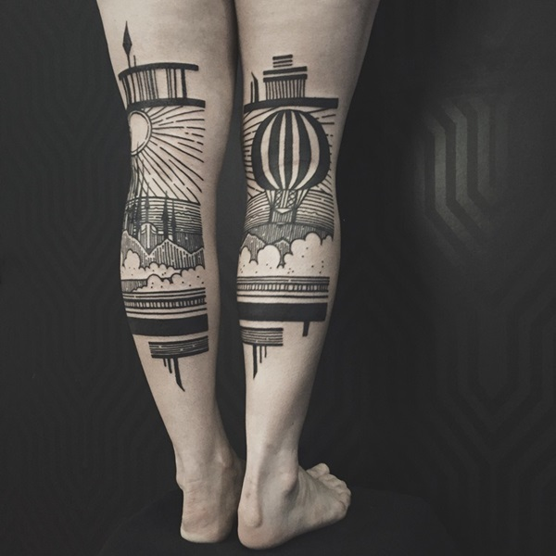
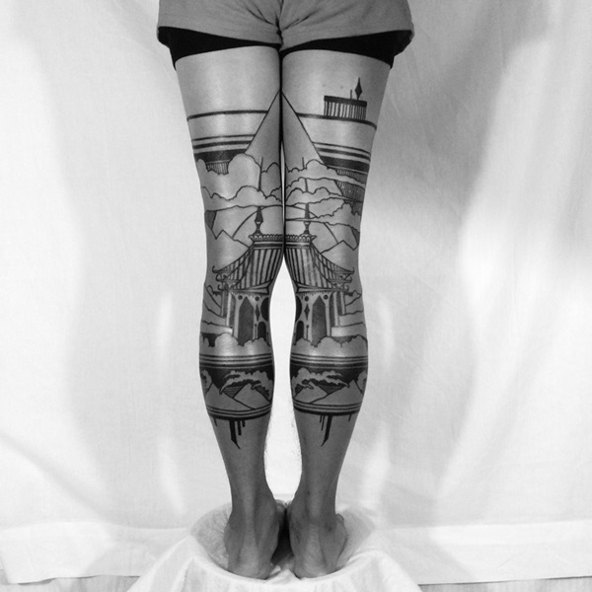
Or Places

Slide 7
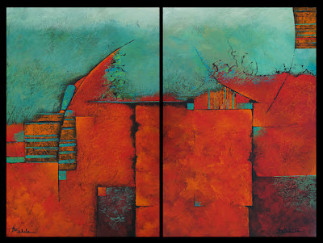
Play with Art Elements

Slide 8
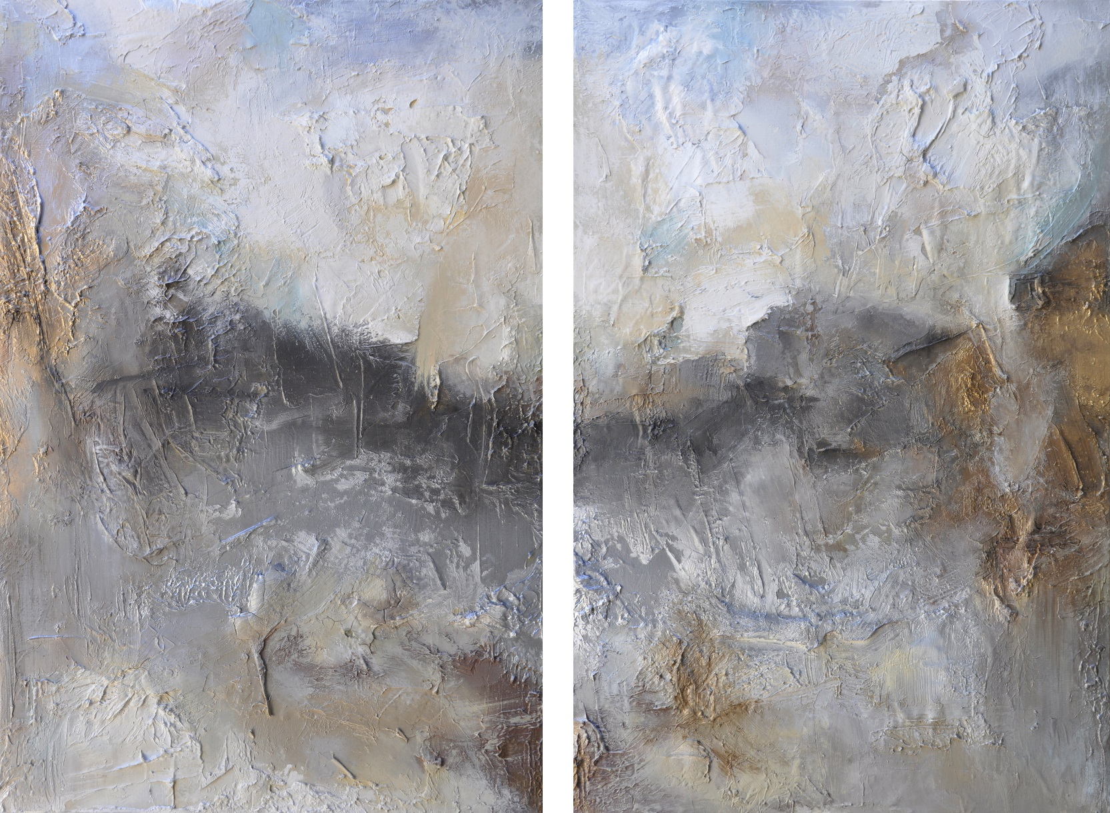
And Principles of Design

Slide 9
Techniques to Consider for Your Diptych

Slide 10
Zoom!

Slide 11
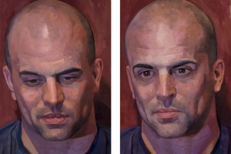
Show time passing

Slide 12
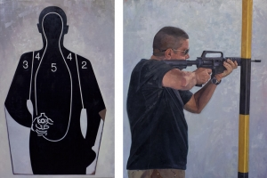
Make connections

Slide 13
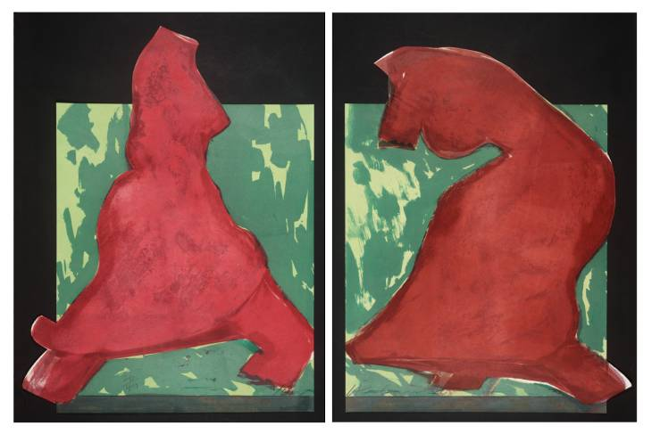
Make the viewer work

Slide 14
Here’s what you need to do:

Slide 15
Your diptych painting will fulfill one of the following:
Depicts a landscape
Tells a story (narrative)
Non-Objective (1 art element + 1 principle of design)
AP – Your Concentration
Consider:
Orientation
Color Scheme
ORIGINALITY
The 4 C’s
What interests you?
No opposites!

