Slide 2
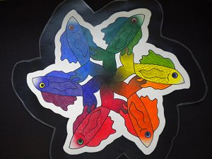

Slide 4
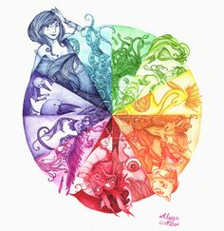

Slide 5
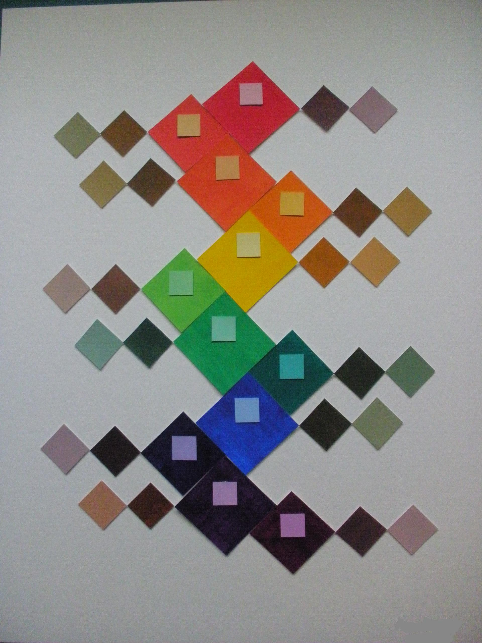

Slide 7
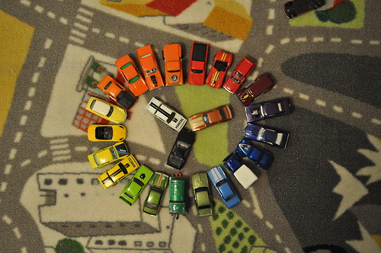

Slide 8
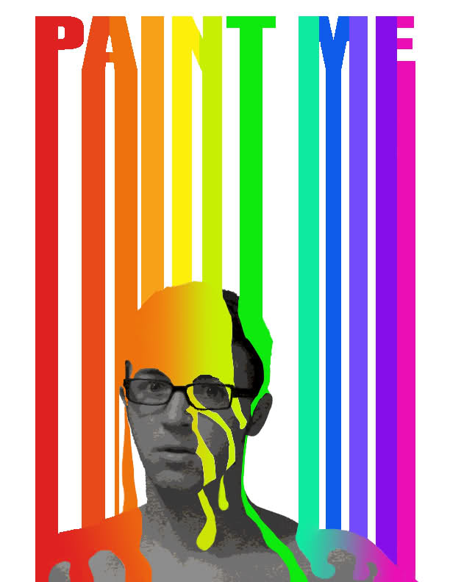

Slide 9
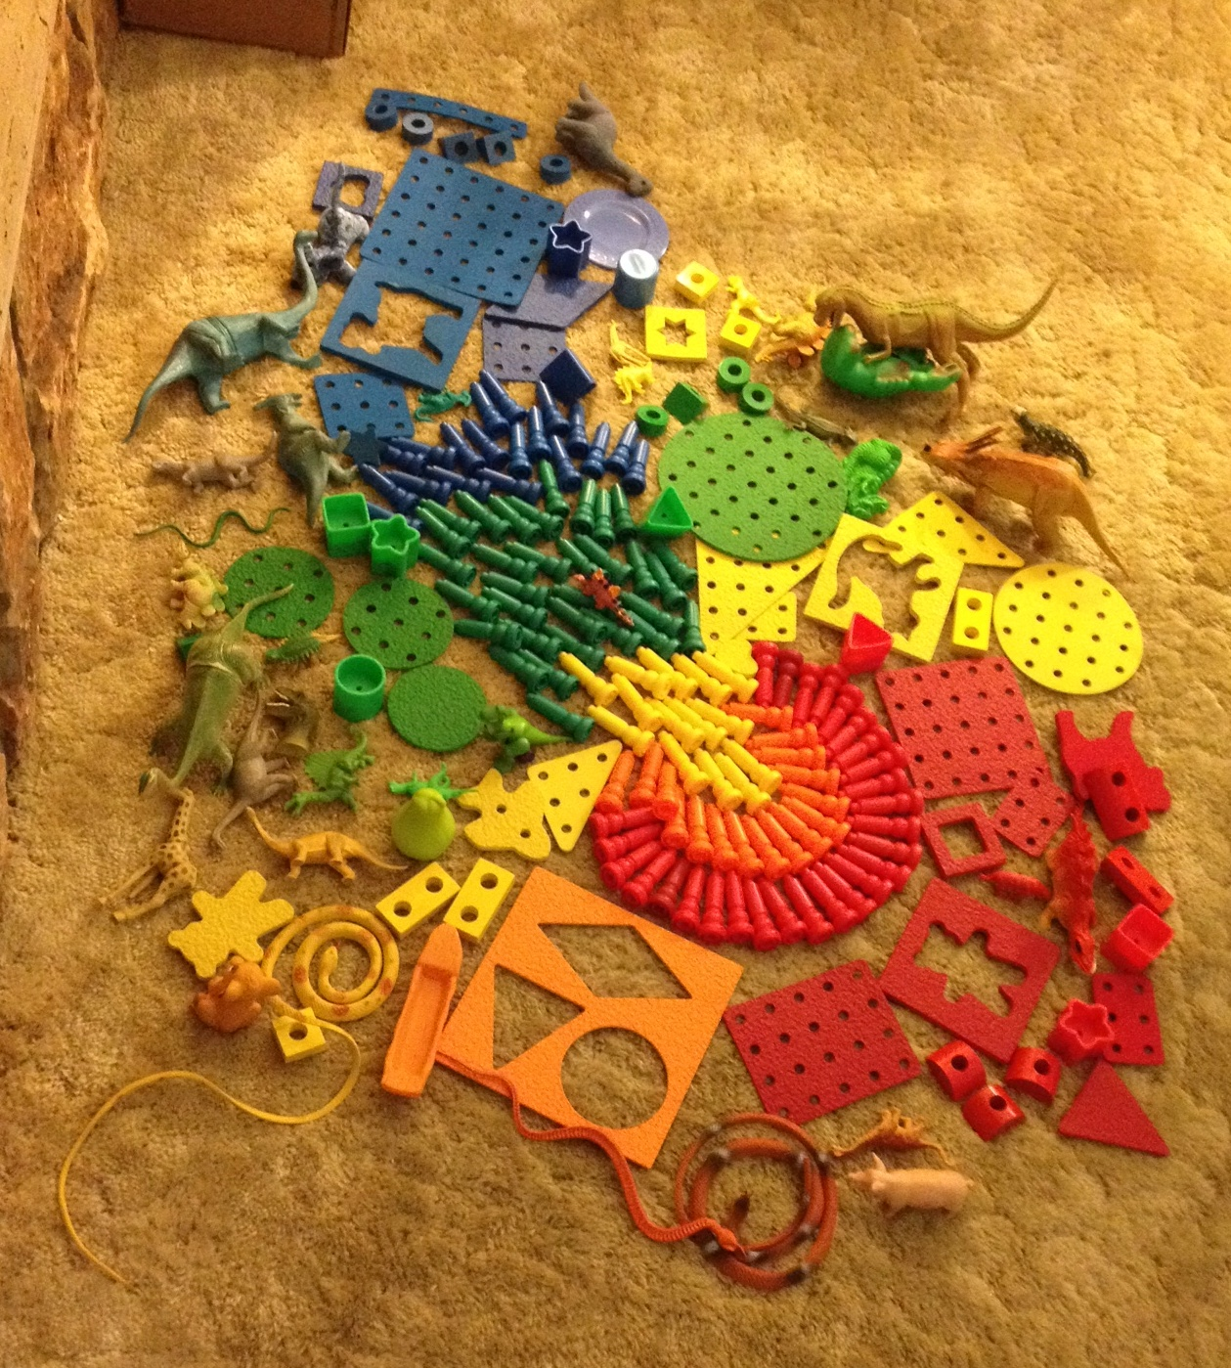

Slide 10
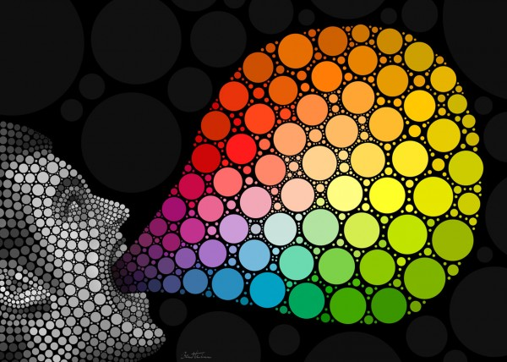

Slide 11
Your Color Wheel Interpretation needs:
All Primary, Secondary and Intermediate(Tertiary) colors
Multiple shades and tints
At least one neutral color
Colors should be arranged in a creative, logical order
Your interpretation should be carefully and skillfully painted
Use your own original ideas!
Begin rough sketches in your sketchbook

