Slide 1
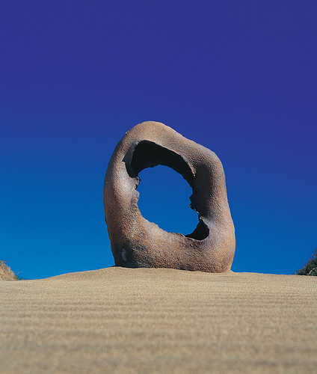
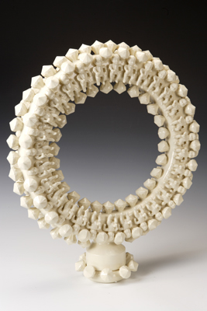
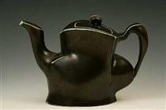
Ceramics
Notes:
Sam Chung, Yang, Nikki Blair

Slide 2
Ceramic objects are made with inorganic, non-metallic materials that are heated and then cooled. These materials tend to be strong, but brittle.
These objects include:
Pottery
Bricks
Glass
Roof and floor tiles

Slide 3
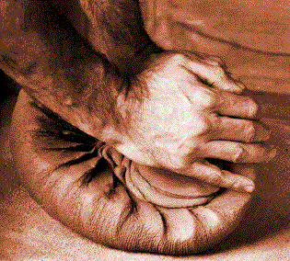
Preparing Clay
Before making anything with clay, whether by hand or on the pottery wheel, the clay must be wedged so that it can survive the firing process. Pottery will explode in the kiln if air bubbles or impurities are in the clay or if certain areas are drier than others. In order to remove any air bubbles and evenly distribute water throughout the clay, it must be repetitively kneaded.

Slide 4
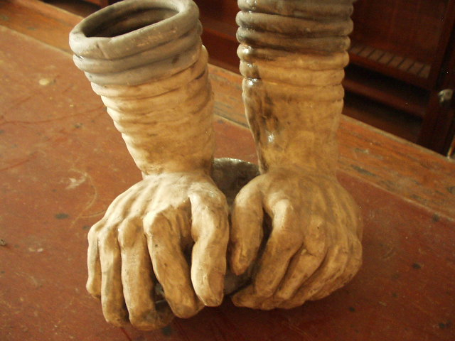
Wedging
Working clay on a surface with the palms of the hands in order to remove air from it and obtain a uniform consistency

Slide 5
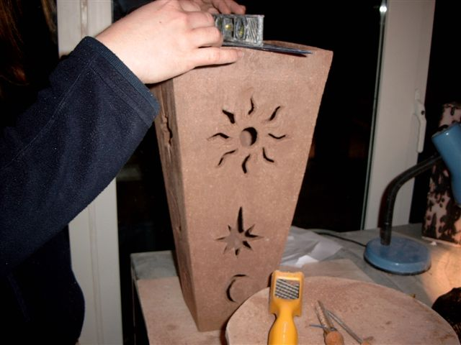
Leather hard
The condition of unfired clay when most of the moisture has evaporated leaving it still soft enough to be carved into or joined to other pieces.

Slide 6
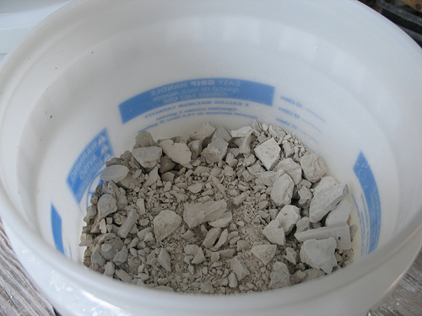
Bone dry
The condition of unfired clay when it is as dry as possible prior to firing

Slide 7
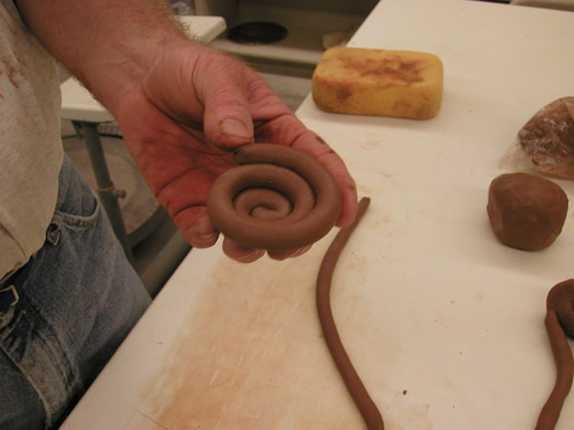
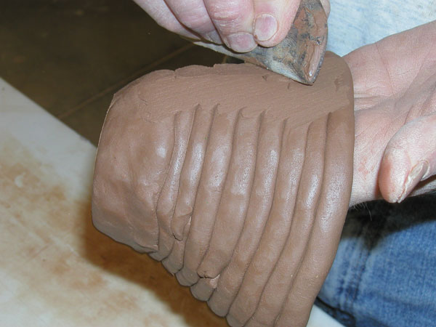
Coil
A rope-like roll of clay used in hand building

Slide 8
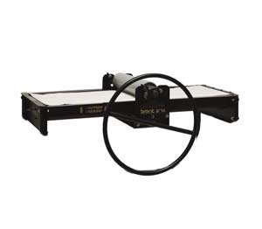
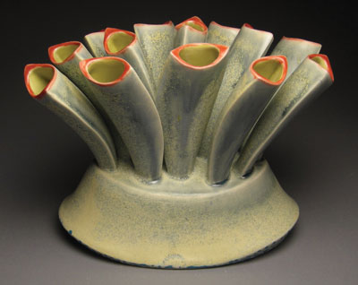
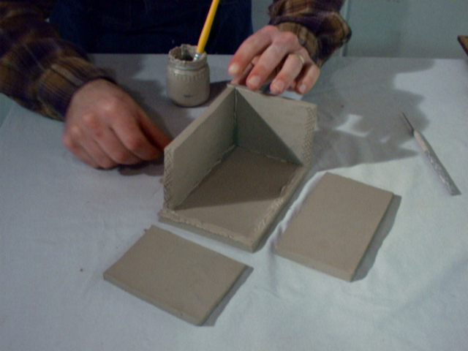
Slab Building
Slab building involves rolling out the clay into flat slabs with a rolling pin or a slab rolling machine. Slabs have to be attached through a process called slipping and scoring.

Slide 9
Slip
A creamy mixture of clay and water often used as a glue to bond two pieces of clay together
Scoring
Roughing up the surface of the clay, usually with a tool. This allows you to firmly attach pieces of clay together.

Slide 10
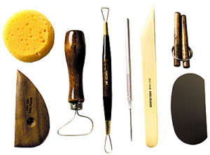
Clay Modeling Tools
Clockwise from bottom left: wood rib, sponge, ribbon tool, loop tool, needlepoint tool, wood modeling tool, wire clay cutter, steel rib
Notes:
Show examples

Slide 11
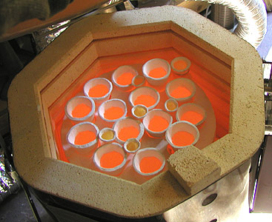
Firing
The heating of clay or glaze to a specific temperature

Slide 12
Kiln
A furnace, built of refractory (resistant to heat and melting) material, for firing ceramic ware

Slide 13
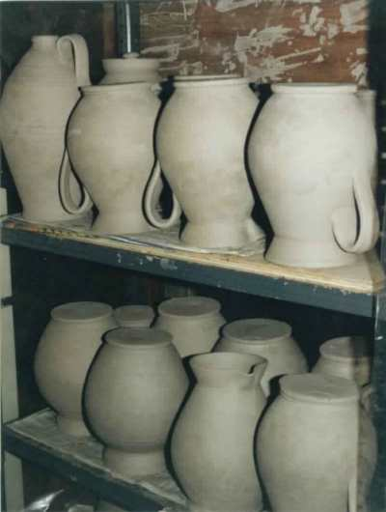
Greenware
Unfired clay pieces

Slide 14
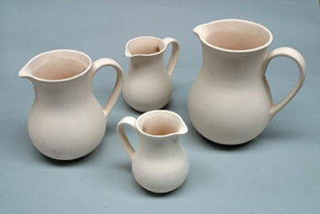
Bisqueware
Clay pieces which have been fired once and are unglazed

Slide 15
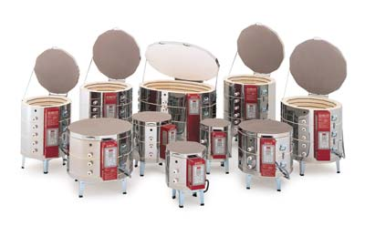
Kilns and Firing
Kilns are used to fire pottery
Pottery is considered to be in the greenware stage until it is fired
After its first firing, it is bisqueware
Bisqueware can be covered with coats of glaze and fired again numerous times
Notes:
After you have finished your piece, you can allow it to dry out gradually. Once your piece has become stiff and is no longer shrinking, it is considered leather hard. Greenware, however, cannot be fired until it is bone dry to assure that there is not enough water within the clay to boil in the kiln and cause your piece to explode. The initial firing is called the bisque fire, and pottery is called bisqueware after its first firing. Bisqueware is ready to be glazed and fired again.

Slide 16
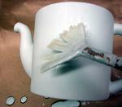
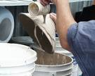
Glaze Techniques
Glazes can be applied with any technique imaginable. The most common applications are painting, dipping, or spraying.
Notes:
Glazing is often the coolest part of making a piece. Glazes can be applied any way you can think of. You can paint the glaze on with a paintbrush, dunk your piece in a bucket of glaze, spray glaze on with an airbrush, or even spin it on the pottery wheel and drizzle the glaze over it.

Slide 17
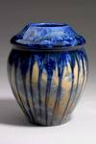
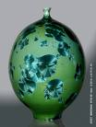
Glaze
A glass-like coating that is bonded to a surface through heat. Glaze is used for decoration and to seal the porous surface of the clay.

Slide 18
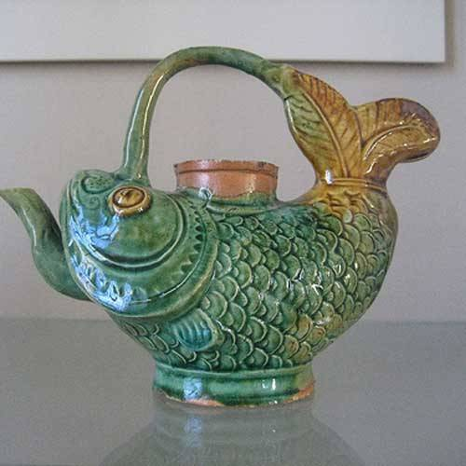
Glaze Firing
A second kiln firing after the initial bisque firing in which glaze materials are heated sufficiently to melt and form a glass-like coating over ceramic pieces when cooled

