Slide 1
Art Synectics - Tools for Creative Thinking

Slide 2
Synectics Definition
The term Synectics is from the Greek word synectikos, which means “bringing forth together,” or “bringing different things into unified connection.”
Synectics is about making connections.
Notes:
Visual analogies-http://coe.sdsu.edu/eet/articles/Visanal/start.htm
Visual Analogies-A Creative Communication Option
Visual Analogies http://graphicdesign.spokanefalls.edu/tutorials/process/visualanalogy/visanalogy.htm#top

Slide 3
It is a way of mentally taking things apart and putting them together to furnish new insight for all types of problems.
Notes:
http://members.optusnet.com.au/charles57/Creative/Techniques/synectics.htm
Another person looked at the way leaves fell together in a pile invented Pringles potato chips.

Slide 4
Synectic thinking is the process of discovering the links that unite seemingly disconnected elements.
The Synectic Triggers
Synectic Trigger mechanisms catalyze or create new thoughts, ideas and inventions.
Notes:
Synectic thinking is the process of discovering the links that unite seemingly disconnected elements.
A man was walking through a field and got a burr caught in his sock. He looked at the burr under the microscope and noticed the plant had a hook that looped around the sock fibers. He combined the idea of the hook with a fiber it could capture and invented Velcro. That’s synectic thinking. Two disconnected ideas merge to become a new idea.

Slide 5
The 23 Design Synectic Triggers
Subtract | Change Scale | Prevaricate
Repeat | Substitute | Analogize
Combine | Fragment | Hybridize
Add | Isolate | Metamorphose
Transfer | Distort | Symbolize
Empathize | Disguise | Mythologize
Animate | Contradict | Fantasize
Superimpose | Parody

Slide 6
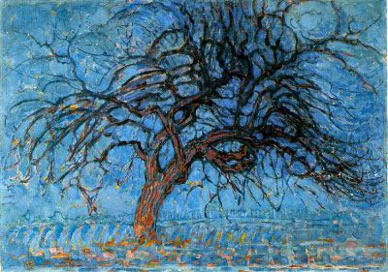
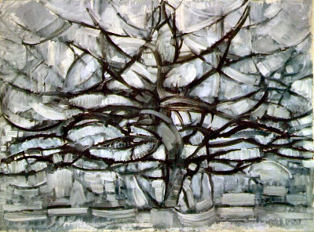
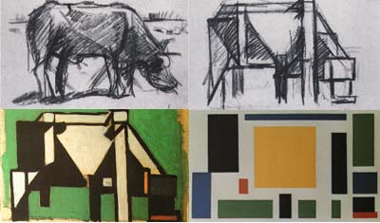
Piet Mondrian tree series
Subtract. Simplify. Omit, remove certain parts or elements.
Take something away from your subject. Compress it or make it smaller.
Think: What can be eliminated, reduced, disposed of? What rules can you break? How can you simplify, abstract, stylize or abbreviate?
Theo Van Doesburg Composition (the cow)

Slide 7
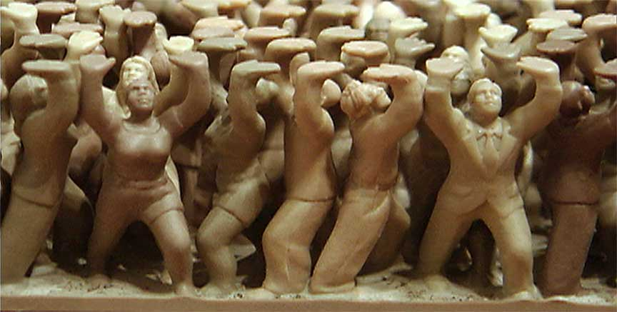
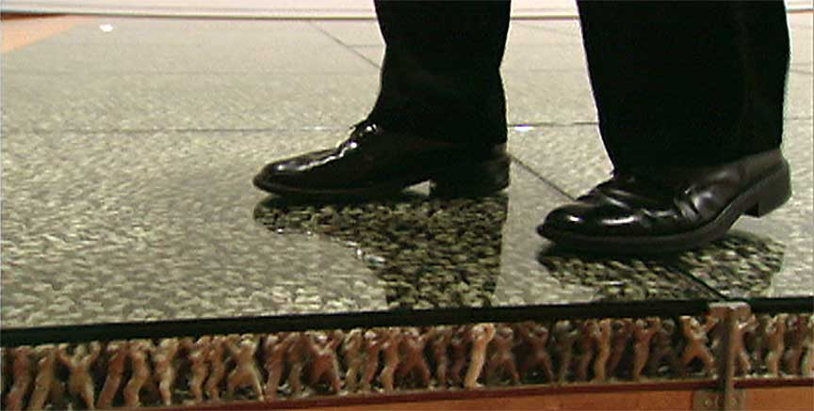
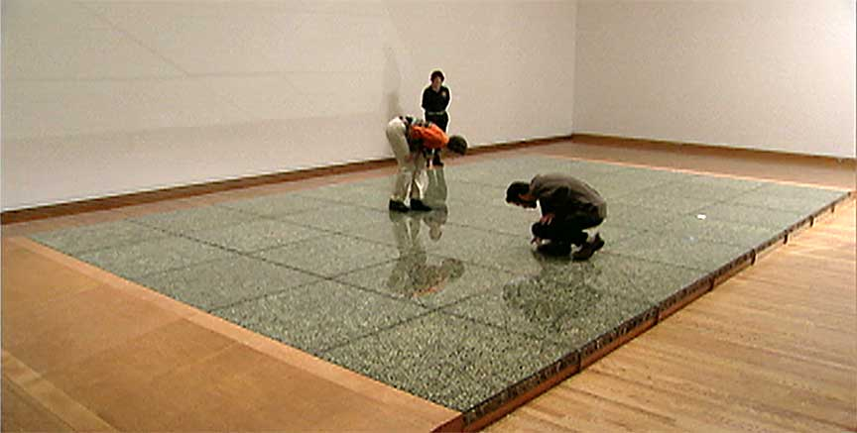
DO-HO SUH
Repeat. Repeat a shape, color, form, image or idea. Reiterate, echo, restate or duplicate your reference subject in some way.

Slide 8
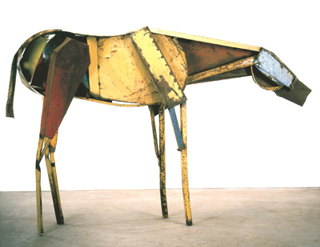
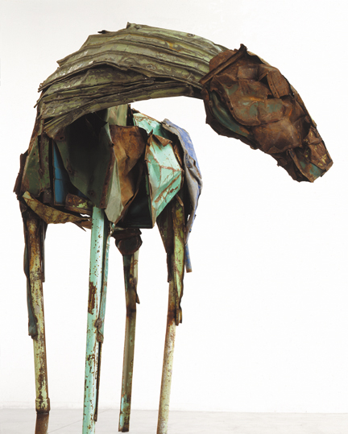
Deborah Butterfield, Palma, 1990, found steel, welded.
Combine. Bring things together. Connect, arrange, link, unify, mix, merge, wed, rearrange. Combine ideas. Combine ideas, materials
and techniques. Bring together dissimilar things to produce synergistic integrations.
What kind of connections can you make from different sensory modes, frames of reference or subject disciplines?

Slide 9
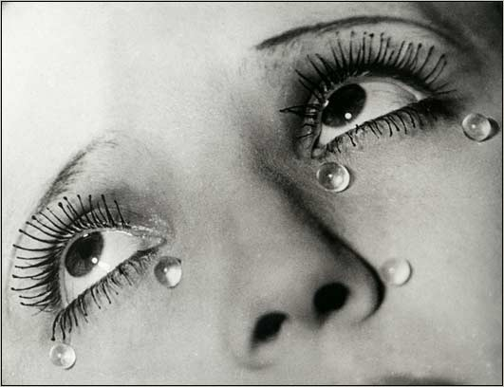
Add. Extend, expand, or otherwise develop your reference subject. Augment it, supplement, advance or annex it, Magnify it: Make it bigger.
Think: What else can be added to your idea, image, object, or material?
Man Ray

Slide 10
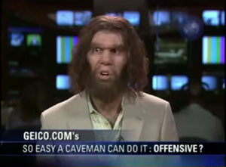
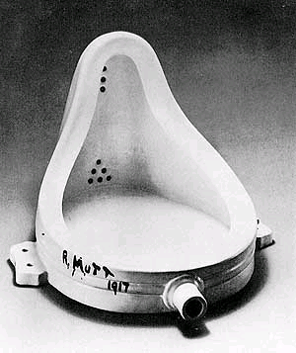
Transfer. Move your subject into a new situation, environment or context. Adapt, transpose, relocate, dislocate. Adapt the subject to a new and different frame of reference. Move the subject out of its normal environment; transpose it to a different historical, social, geographical or political setting or time. Look at it from a different point of view.
Think: How can your subject be converted, translated, or transfigured?
Marcel Duchamp

Slide 11
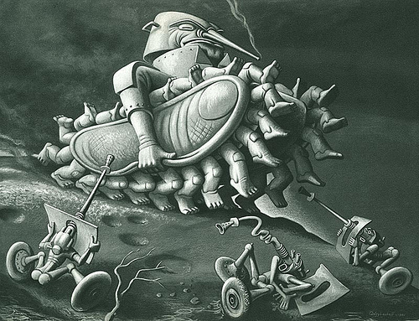
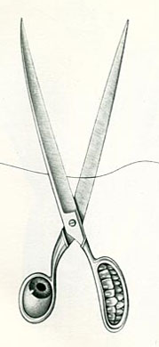
Boris Artzybasheff
Animate.
Bring life to inanimate subjects by thinking of them as having human
qualities.

Slide 12
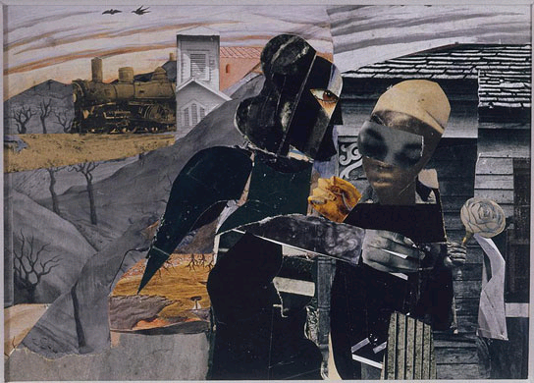
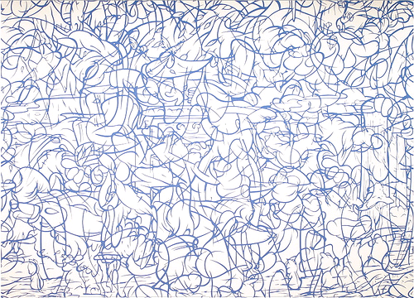
Romare Bearden, Prevalence of Ritual: Tidings, 1964
Superimpose. Overlap, place over, cover, overlay: Superimpose dissimilar images or ideas. Overlay elements to produce new images, ideas or meanings. Superimpose different elements from different perspectives, disciplines or time periods on your subject.
Arturo Herrera, Untitled 2005

Slide 13
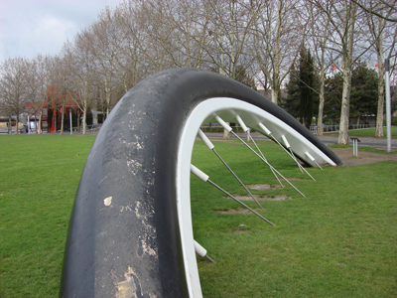
Claes Oldenburg Bicycle Wheel
Change Scale. Make your subject bigger or smaller. Change proportion, relative size, ratio, dimensions or normal graduated series.
Ron Mueck, Spooning couple

Slide 14
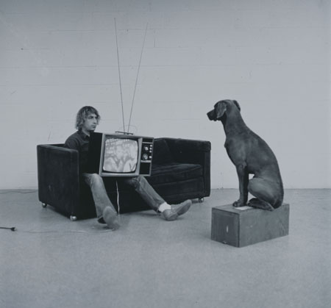
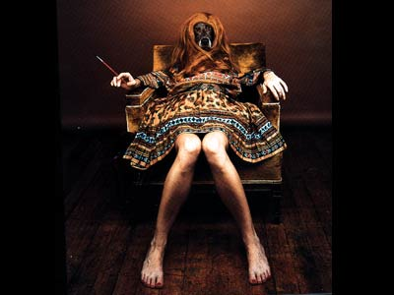
Substitute. Exchange, switch or replace: Think: What other idea, image, material or ingredient can you substitute for all or part of your
subject?
William Wegman

Slide 15
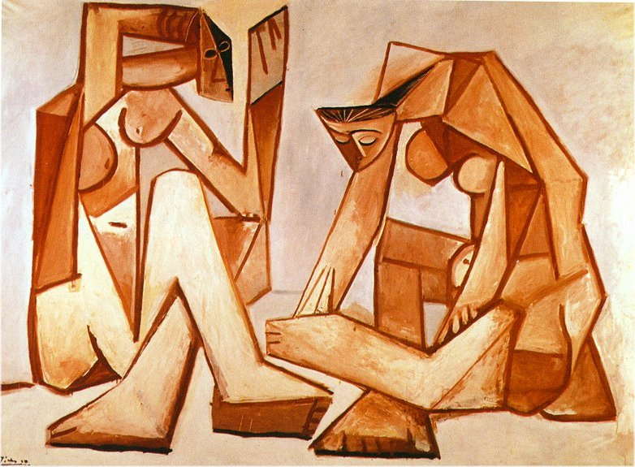
Picasso
Fragment. Separate, divide, split: Take your subject or idea apart. Dissect it. Chop it up or otherwise disassemble it. What devices can you use to divide it into smaller increments- or to make it appear discontinuous?

Slide 16
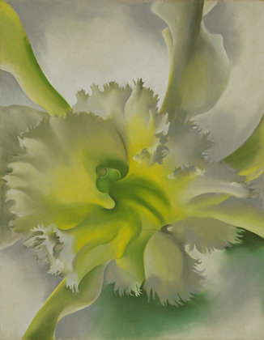
Isolate. Separate, set apart, crop, detach: Use only a part of your subject. In composing a picture, use a viewfinder to crop the image or
visual field selectively. "Crop" your ideas, too, with a "mental" viewfinder. Think: What element can you detach or focus on?
Georgia O‘Keeffe, The Orchid 1941

Slide 17
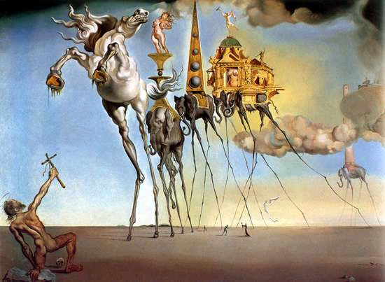
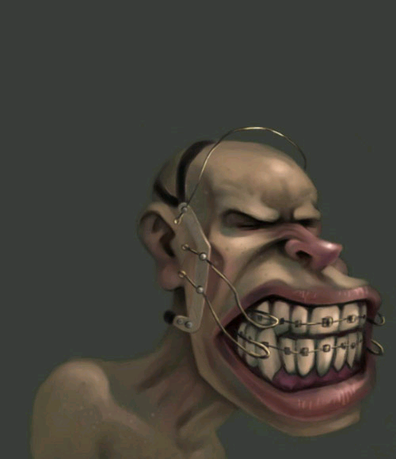
Rocky Davies, BraceFace
Salvador Dali, Temptation of St. Anthony
Distort. Twist your subject out of its true shape, proportion or meaning. Think: What kind of imagined or actual distortions can you
effect? How can you misshape it? Can you make it longer, wider, fatter, narrower? Can you melt it, burn it, crush it, spill something on it, bury it, crack it, tear it or subject it to
yet other "tortures"?

Slide 18
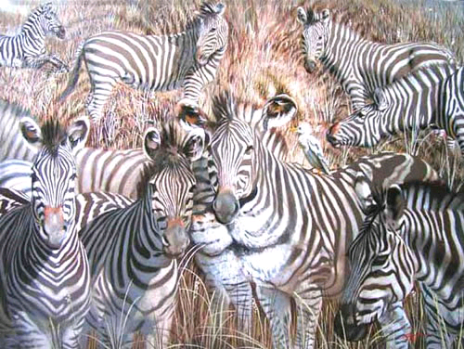
Donald "Rusty" Rust
Disguise. Camouflage, conceal, deceive or encrypt: How can you hide, mask or "implant' your subject into another frame of reference?
In nature, for example, chameleons, moths and certain other species conceal themselves by mimicry: Their figure imitates the ground.
How can you apply this to your subject?

Slide 19
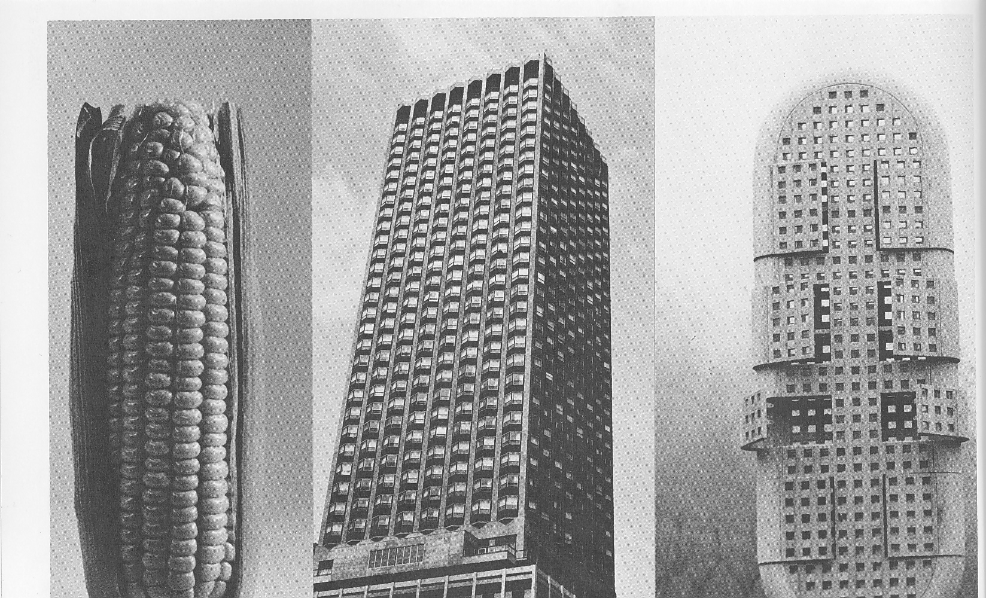
Hybridize. Cross-fertilize: Wed your subject with an improbable mate. Think: "What would you get if you crossed a ______ with a_____?"
Creative thinking is a form of "mental hybridization" in that ideas are produced by cross-linking subjects from different realms.
Transfer the hybridization mechanism to the use of color, form and structure; cross-fertilize organic and inorganic elements, as well as ideas and perceptions.

Slide 20
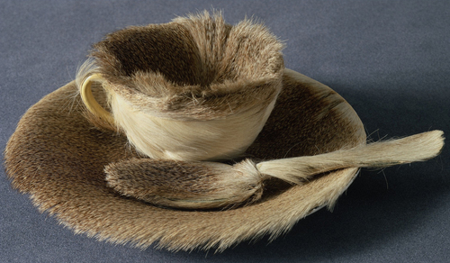
Meret Oppenheim
Contradict. Contradict the subject’s original function. Contravene, disaffirm, deny, reverse: Many great works of art are, in fact, visual and intellectual contradictions. Contradict laws of nature such as gravity, time, etc. Think: How can you visualize your subject in connection with the reversal of laws of nature, gravity, magnetic fields, growth cycles, proportions; mechanical and human functions, procedures, games, rituals or social conventions?
Think: How can you use contradiction or reversal to change
your subject?

Slide 21
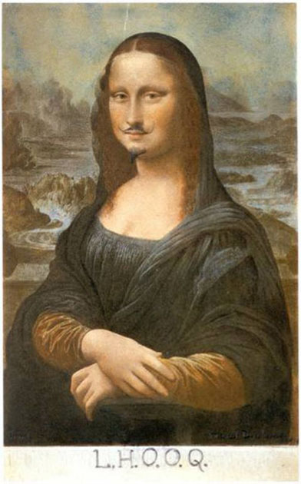
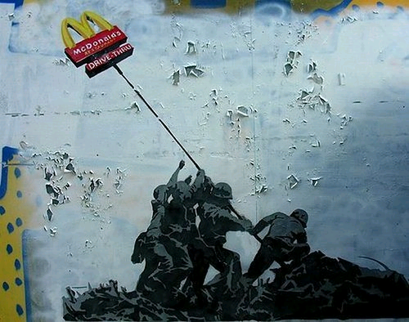
Street artist unknown
Parody. Ridicule, mimic, mock, burlesque or caricature: Make fun of your subject. "Roast' it, lampoon it. Transform it into a visual joke or pun. Exploit the humor factor, Make zany, ludicrous or comic references. Create a visual oxymoron or conundrum.
Marcel Duchamp , L.H.O.O.Q.

Slide 22
Prevaricate. Equivocate. Fictionalize, "bend" the truth, falsify, fantasize. Although telling fibs is not considered acceptable social conduct, it is the stuff that legends and myths are made of.
Duane Hanson, Drug Addict ,sculpture 1975

Slide 23
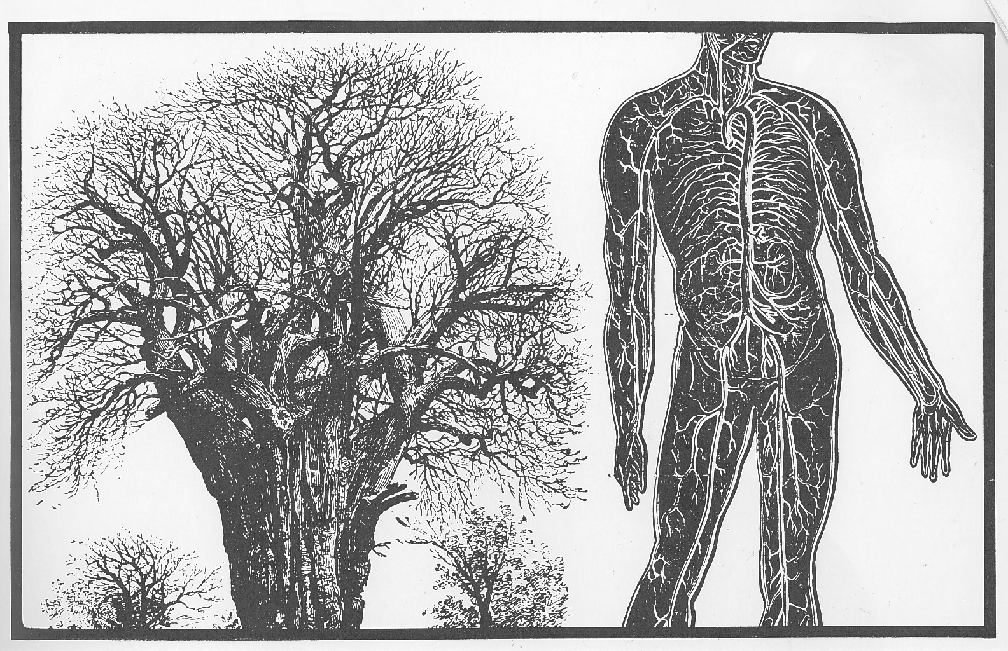
Analogize. Compare. Draw associations: Seek similarities between things that are different. Make comparisons of your subject to elements from different domains, disciplines and realms of thought. Think: What can I compare my subject to? What logical and illogical associations can I make? Remember, stretching analogies is a way of generating creative outcomes, new perceptions and potent metaphors.

Slide 24
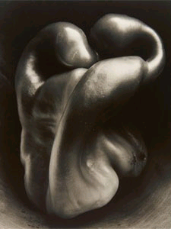
Empathize. Sympathize. Relate to your subject; put yourself in its "shoes." If the subject is inorganic or inanimate, think of it as having human qualities. How can you relate to it emotionally or subjectively?
Transpose yourself into your subject.
Edward Weston, pepper 1930

Slide 25
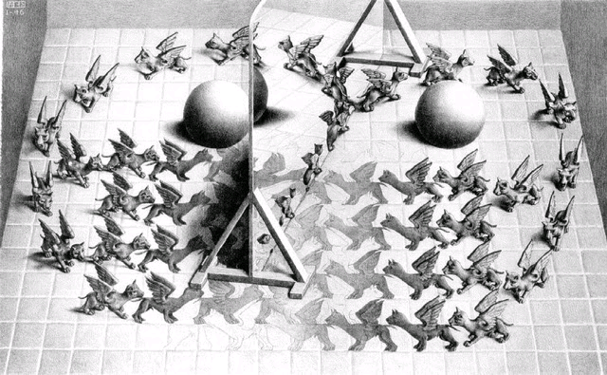
M.C. Escher magic mirror 1946
Metamorphose. Transform, convert, transmutate: Depict your subject in a state of change. It can be a simple transformation (an object changing its color, for example) or a more radical change in which the subject changes its configuration. Think of "cocoon-to-butterfly" types of transformations, aging, structural progressions, as well as radical and surreal metamorphosis such as "Jekyll and Hyde" transmutations.
How can you apply metamorphosis or mutation to your subject?

Slide 26
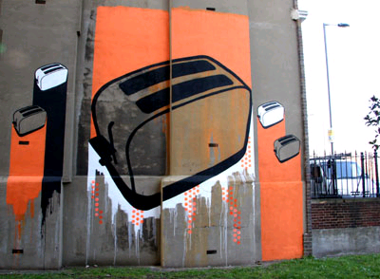
Shepard Fairey, OBEY series
The Toasters
Symbolize. How can your subject be imbued with symbolic qualities?
A visual symbol is a graphic device which stands for something other than what it is. (For example, a red cross stands for first aid, a striped pole for a barber shop, a dove bearing an olive branch for peace, etc.) Public symbols are clichés insofar as they are well-known and widely understood, while private symbols are cryptic and have special meaning only to their originator. Works of art are often integrations of both public and private symbols.
Think: What can you do to turn your subject into a symbolic image? What can you do to make it a public symbol? A private metaphor?

Slide 27
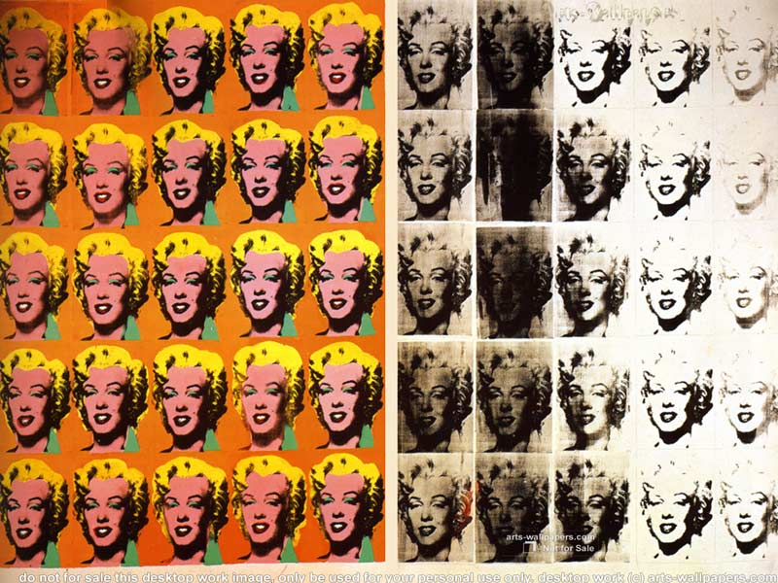
Andy Warhol, Marilyn Diptych
Mythologize. Build a myth around your subject.
In the 60's, Pop artists "mythologized" common objects. The Coca-Cola bottle, Brillo Pads, comic strip characters, movie stars, mass media images, corporate logos and other subjects became the visual icons of twentieth century art.
Think: How can you transform your subject into an iconic object?

Slide 28
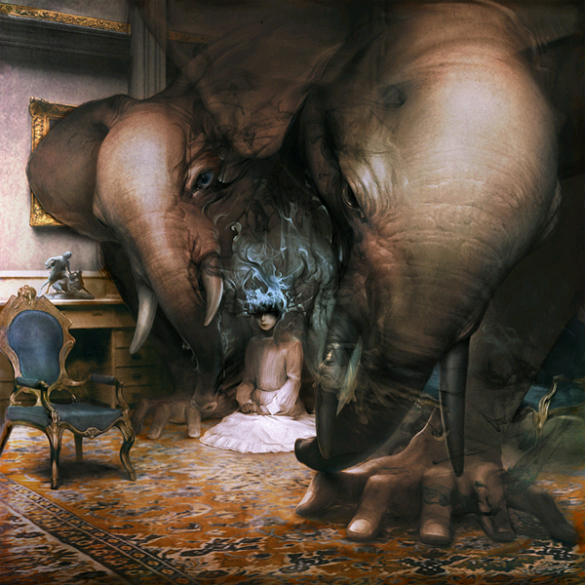
Fantasize. Fantasize your subject. Use it to trigger surreal, preposterous, outlandish, outrageous, bizarre thoughts.
Think: "What-if" thoughts: What if automobiles were made of brick? What if alligators played pool? What if insects grew larger than humans?
To invent, one must be contrary and go against established conventions and stereotypes. Remember, inventors create great inventions only by breaking the "rules".
Ryohei Hase, The last thing we do

Slide 29
Take Creative Action!
Ideas are not born in a vacuum.
Use the 23 synectic triggers to transform your ideas into something new.
The triggers are tools for transformational thinking and may lead you to some great discoveries.
Notes:
http://members.optusnet.com.au/charles57/Creative/Techniques/synectics.htm

Slide 30
The House/Paint Challenge
Your painting must relate to the idea of “house”
You will use your color and share with other students for other colors
You will choose at least one synectic trigger as a guide for your painting
There should be little to no flat paint on your image
Use blending, sgraffito, double loading, broken color, etc.
Focus on Concept and Craftsmanship!
We will start on cardboard tomorrow, ideas need to be ready!

Slide 31
Art-Think: Ways of Working…
Identity: Set the problem or task, identify the subject. (Assignment)
2. Analyze: Examine the subject; break it down, classify it. (House)
3. Ideate: Think, fantasize, produce ideas. Generate options towards a creative solution. Relate, rearrange, reconstruct. (Ideas!)
4. Select: Choose your best option.
5. Implement: Put your ideas into action. Realize it. Transform imagination and fantasy into tangible form. (Rough sketch)
Evaluate: Judge the result. Think about new options and possibilities that have emerged. Go back to Step #1. (Revise and Adjust)
This is the complex version of Think Make!

