Slide 1
Linoleum Cut Prints
Animal/Insect with
Ground

Slide 2
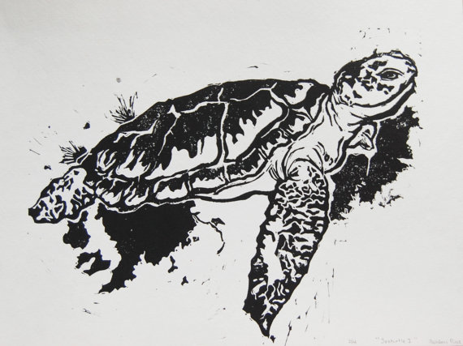

Slide 3
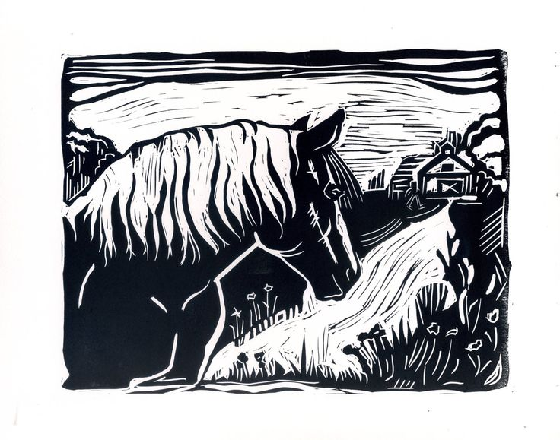

Slide 4
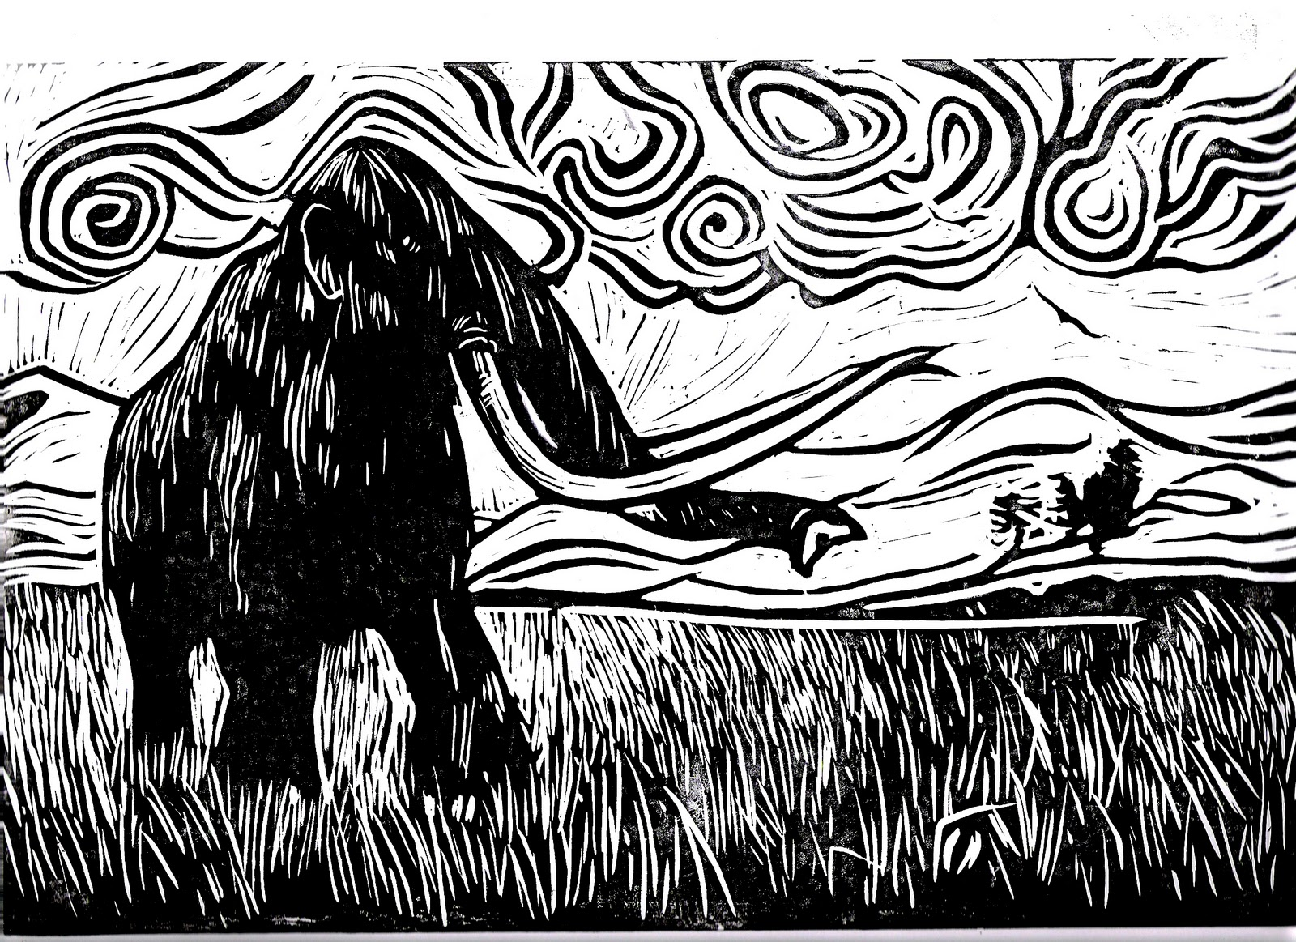

Slide 5
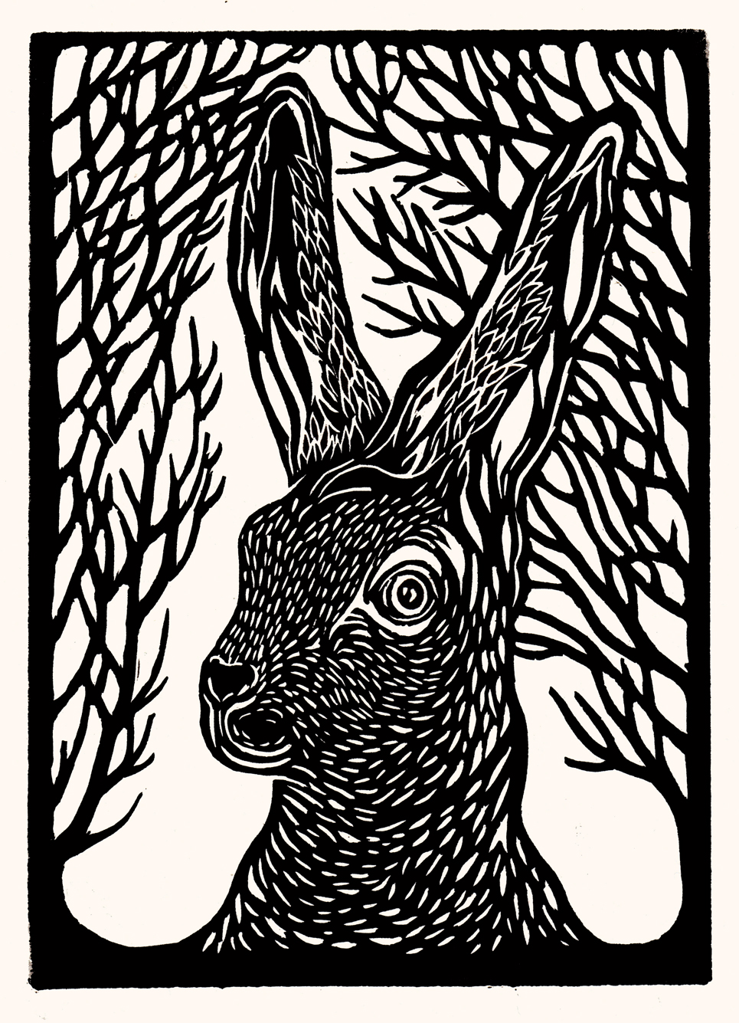

Slide 6
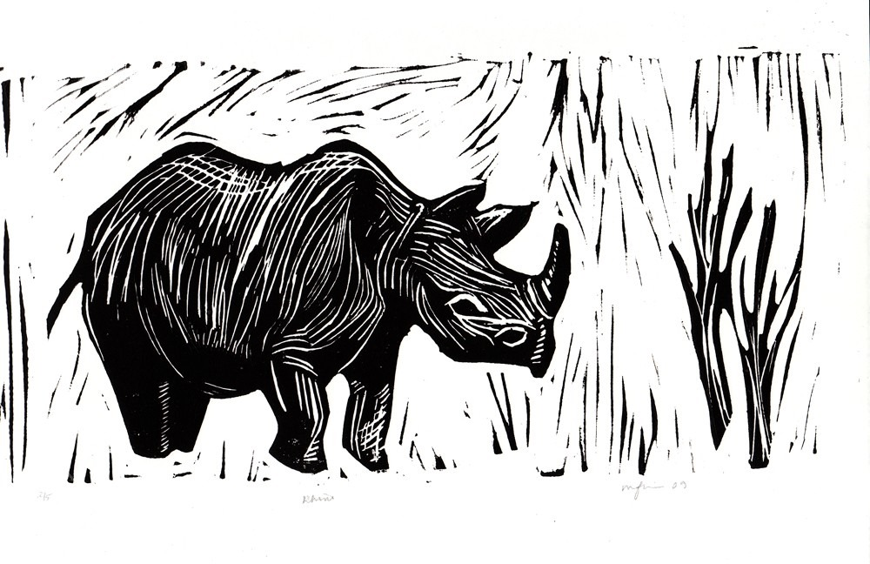

Slide 7
For your Linocut, you will:
Use a realistic animal or insect.
Incorporate a complimentary background (need not be realistic, but must enhance the image).
Have a wide range of values. The image should be no more than 50% black.
Create 3 perfect prints, labeled correctly.

