Slide 1
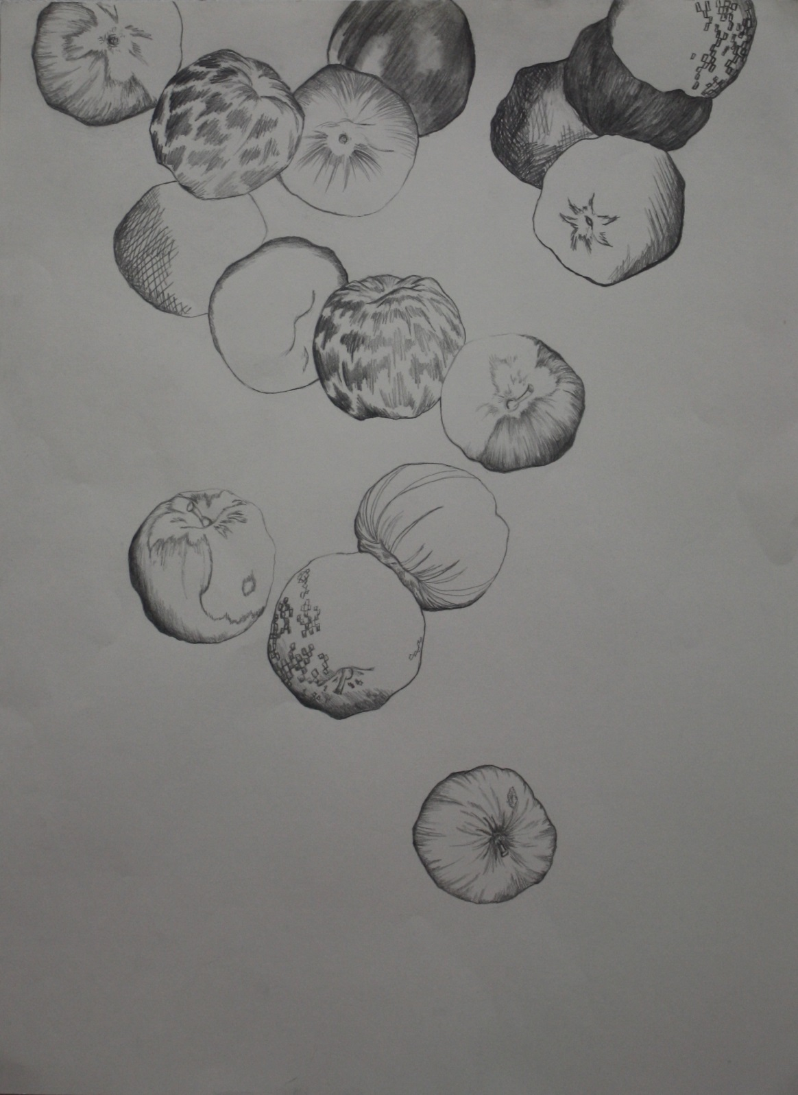

Slide 2
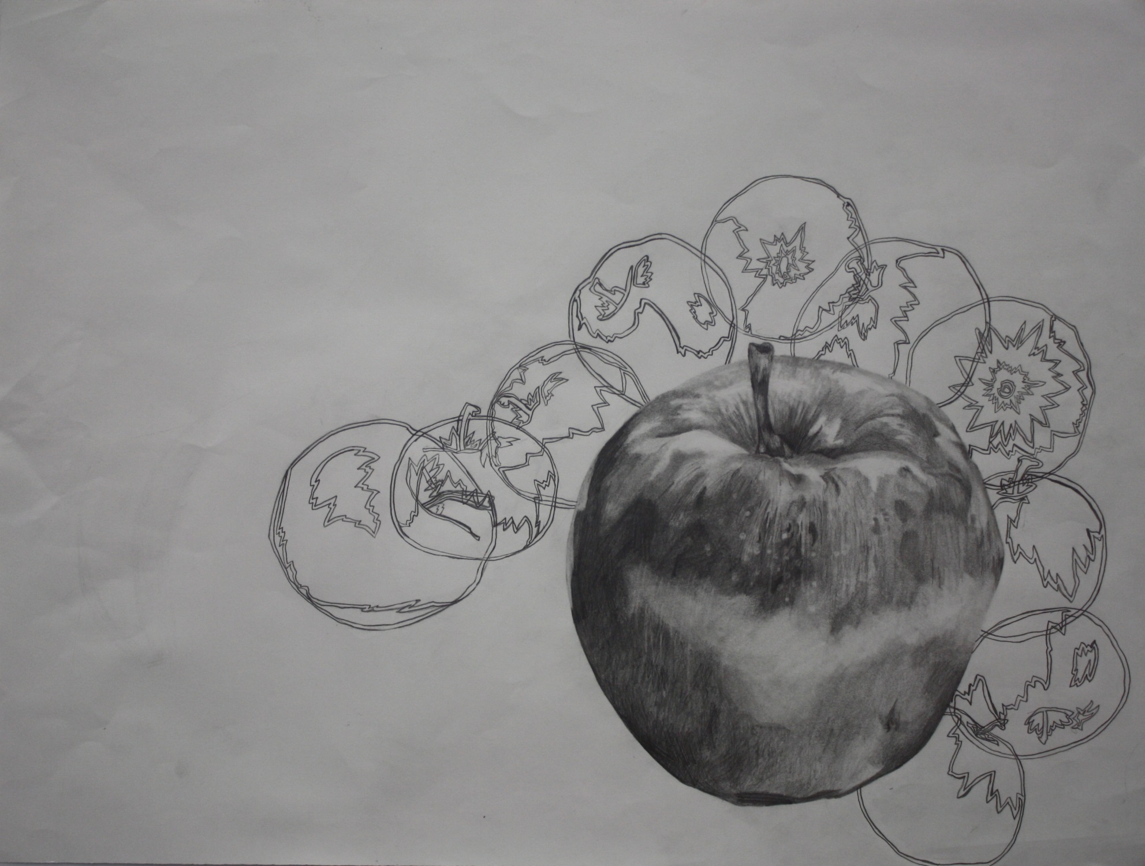

Slide 3
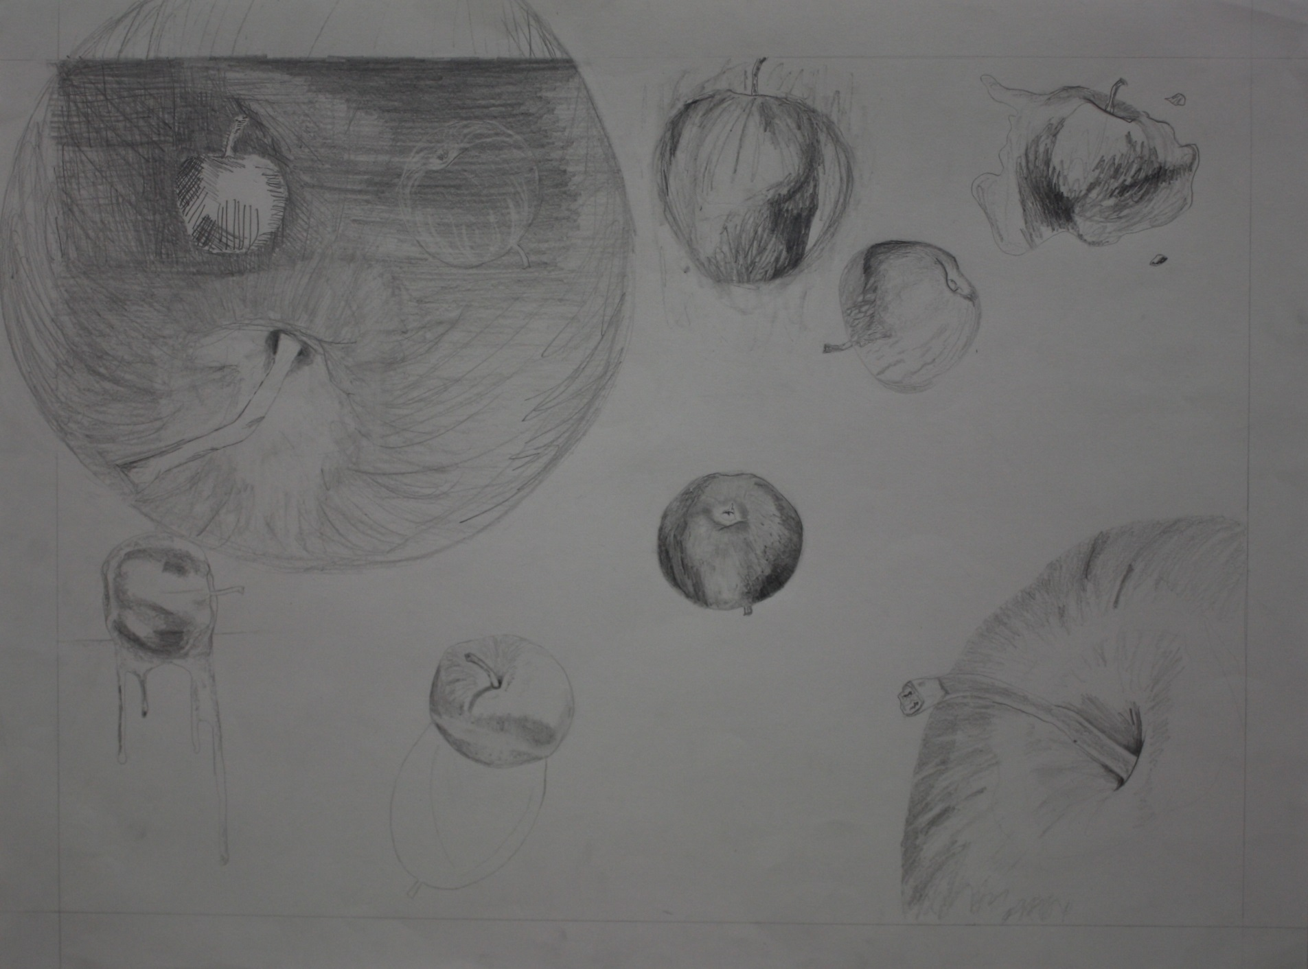

Slide 4
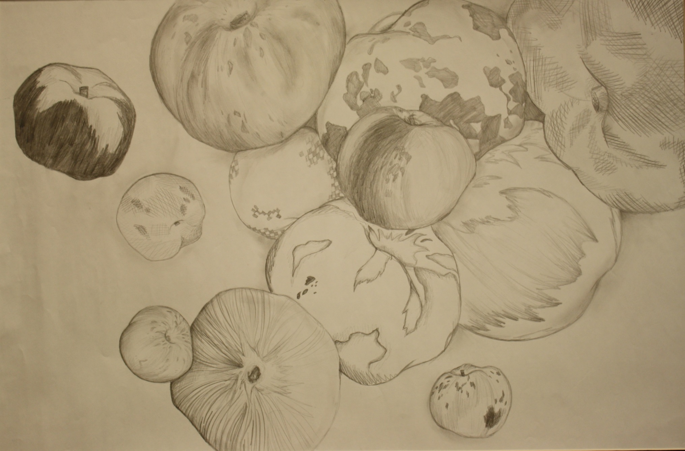

Slide 5
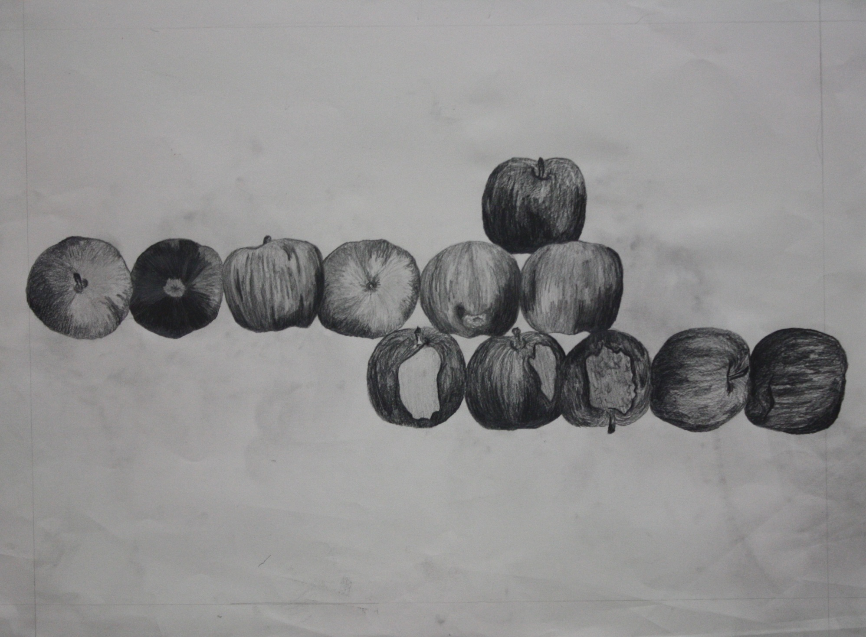

Slide 6
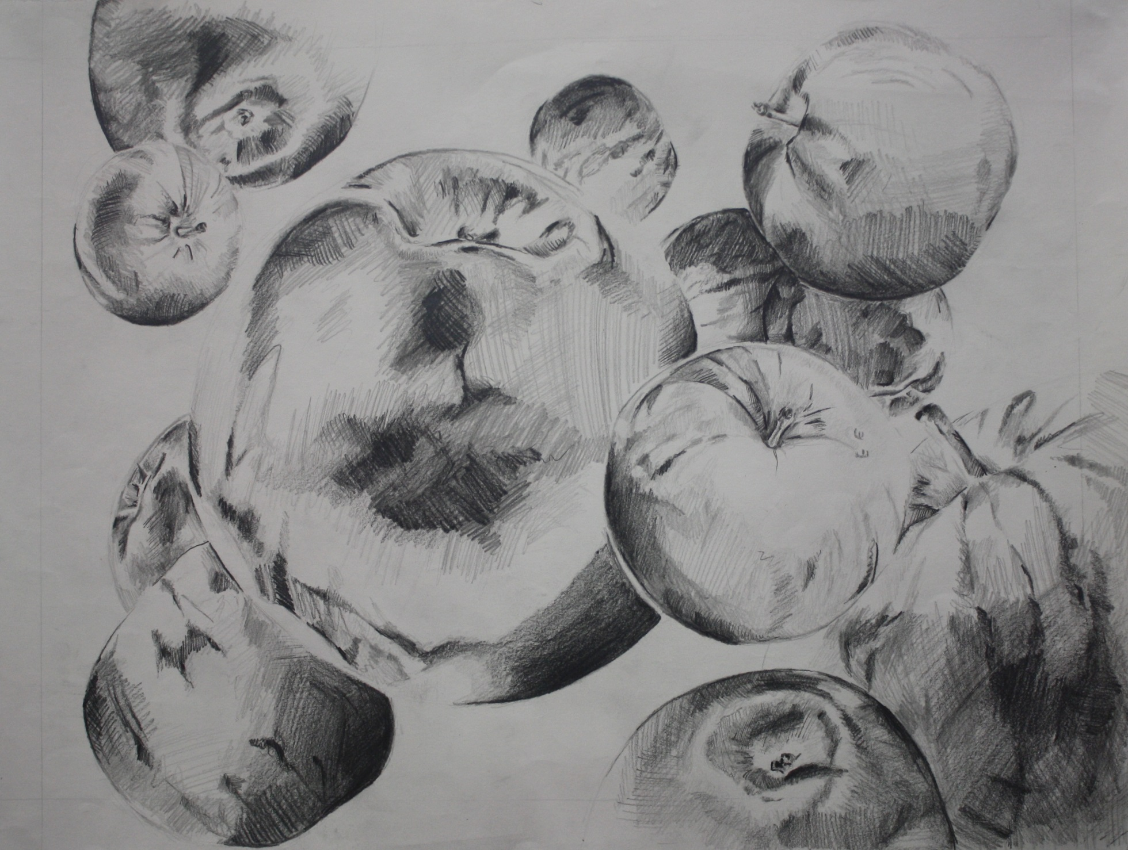

Slide 7
One Dozen Apples
Working in multiples (must have 12)
Wide range of values throughout space
Consider composition
Drawing style/mark making should unite the drawing
Apples only to fill space
Accuracy of shapes is important

